Slide 1

Public Service Loan Forgiveness (PSLF)
Jennifer Achan
Bakersfield College
Office of Financial Aid & Scholarships
11/13/23

Slide 2

PSLF Qualifications
Be employed by a U.S. federal, state, local, or tribal government or qualifying not-for-profit organization (federal service includes U.S. military service);
Work full-time for that agency or organization;
Have Direct Loans (or consolidate other federal student loans into a Direct Loan);
Repay your loans under an income-driven repayment plan or a 10-year Standard Repayment Plan; and
Make a total of 120 qualifying monthly payments that need not be consecutive.

Slide 3
Types of Loans
Eligible
Ineligible
Direct Subsidized Loans
Direct Unsubsidized Loans
Direct PLUS Loans
Direct Consolidation Loans
Federal Family Education Loan (FFEL) Issued 1965-2010
Federal Perkins Loan (Perkins Loan)
Student loans from private lenders

Slide 4
Qualifying Repayment Plans
Saving on a Valuable Education (SAVE) Plan—formerly the REPAYE Plan
Pay As You Earn (PAYE) Repayment Plan
Income-Based Repayment (IBR) Plan
Income-Contingent Repayment (ICR) Plan

Slide 5
The Following Repayment Plans Do Not Qualify For PSLF:
Standard Repayment Plan for Direct Consolidation Loans
Graduated Repayment Plan
Extended Repayment Plan

Slide 6
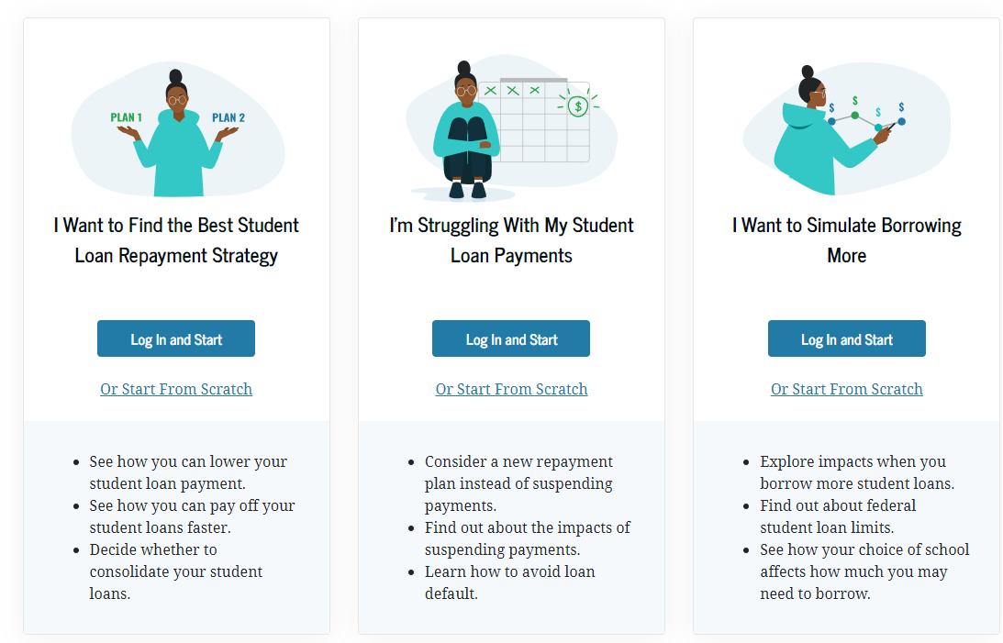
How do I choose?
Loan Simulator | Federal Student Aid

Slide 7
The Following Repayment Plans Do Not Qualify For PSLF:
Standard Repayment Plan for Direct Consolidation Loans
Graduated Repayment Plan
Extended Repayment Plan

Slide 8
Public Service Loan Forgiveness
Additional information
Public Service Loan Forgiveness | Federal Student Aid
Submit your PSLF:
employmentverifications@kccd.edu

