Slide 1

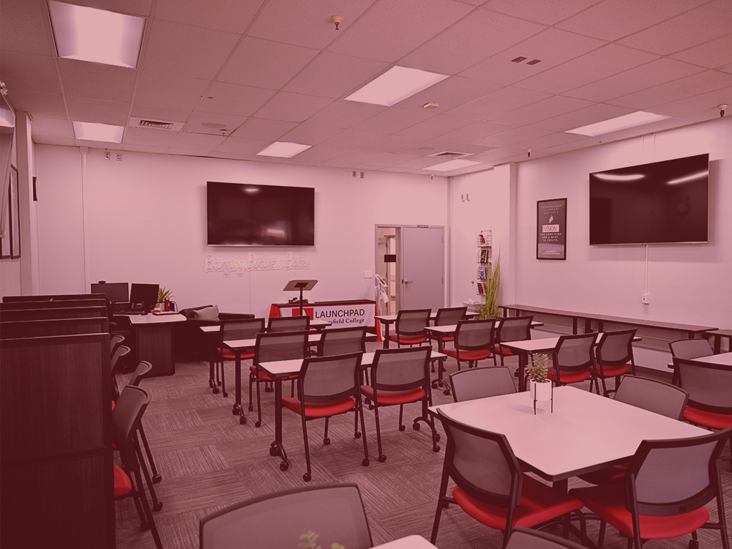
THINK IT.
GROW IT.
LAUNCH IT.

Slide 2
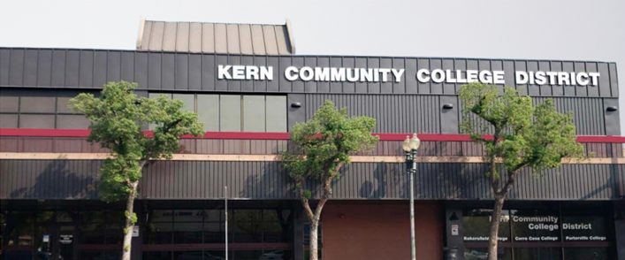
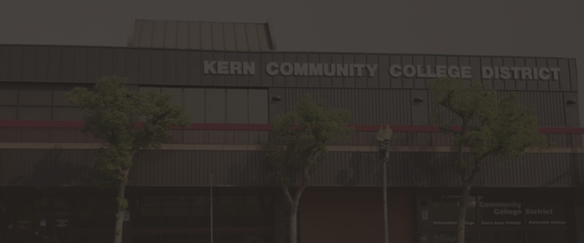




WELCOME TO
BC LAUNCHPAD
Hours of Operation:
Monday - Thursday
10:00am - 3:00pm
By Appointment
Weill Institute
2100 Chester Ave, First Floor
Bakersfield, CA 93301
Read More

Slide 3


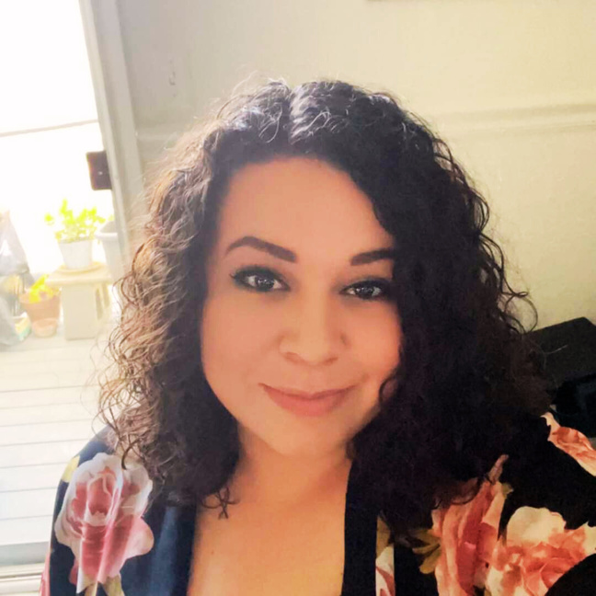


BC LAUNCHPAD
TEAM
Kern Community College District/Bakersfield College
Na”T”esha Johnson, M.P.A., CDI
Tomeka
Powell
Korey
Hammel
Program Director
Community Services Coordinator
Department Assistant III
Entrepreneurship and Workforce Development

Slide 4


our Mission
The BC Launchpad exists to empower it students and all residents of Kern County with entrepreneurial resources to successfully launch and grow small businesses through the delivery of educational opportunities and support services and through fostering collaboration.
Our vision
To increase the number of new entrepreneurs and successful small business owners in Kern County by collaborating with local likeminded community organizations and industry partners within the existing entrepreneurial ecosystem.

Slide 5


WHO SHOULD ATTEND?
YOU!
Whether you have an idea, are just starting out, have been in the workplace, or have an existing business that you wish to grow. This is an effective, convenient, and affordable way to rapidly acquire the skills you need.
We welcome new start-ups and small businesses throughout Kern County... even the "Wantrepreneurs"!

Slide 6

THE ENTREPRENEURSHIP ACADEMY
Certificate of Completion Courses
Entrepreneurship Certificate:
Credits listed are in hours (72 hours) (0 Units)
  OFFTB66NC - Introduction to Entrepreneurship (9 Units)
  OFFTB67NC - Business Plan I: Executive Summary (9 Units)
  OFFTB68NC - Business Plan II: The Organizational Plan (18 Units)
  OFFTB69NC - Business Plan III: The Marketing Plan (9 Units)
  OFFTB70NC - Business Plan IV: The Financial Plan (18 Units)
  OFFTB71NC - Execution of Business Plan (9 Units)
Accelerated Entrepreneurship Certificate of Completion:
*Two week cohort, specifically for those who would like to apply for the Bakersfield City Grant includes all six courses in the Entrepreneurship Certificate.
HOW IT WORKS
WEBINARS, CERTIFICATES, AND CLASSESS
Small Business Development Certificate:
Core Courses-18 hours (Credits listed are in hours) (0 Units)
  OFFTB63NC - Starting a Business (9 - 0 Units)
  OFFTB64NC - The Business Idea (9 - 0 Units)
Small Business Execution Certificate:
Complete the following number of credits: 36-0
  OFFTB65AN - Product Design (9 - 0 Units) OR
  OFFTB65BN - Service Creation (9 - 0 Units)
  OFFTB76NC - Business Branding (9 - 0 Units)
  OFFTB81NC - Creating a Basic Business Website (18 - 0 Units)
Small Business Funding Certificate:
Complete all of the following -
Core Courses-27 hours (Credits listed are in hours) (0 Units)
  OFFTB58NC - High Impact Presentations and Proposals (9 - 0 Units)
  OFFTB77NC - Funding Strategies for Small Business (18 - 0 Units)
We offer several tuition-free noncredit certificates to help improve your business skills.
ENROLL TODAY!
The Entrepreneurship Academy consists of 13 classes and 4 certificates of completion.

Slide 7
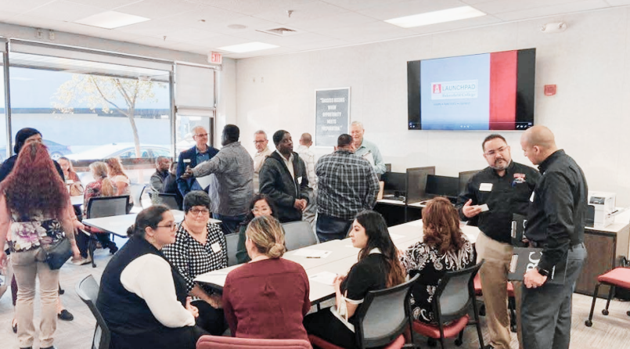
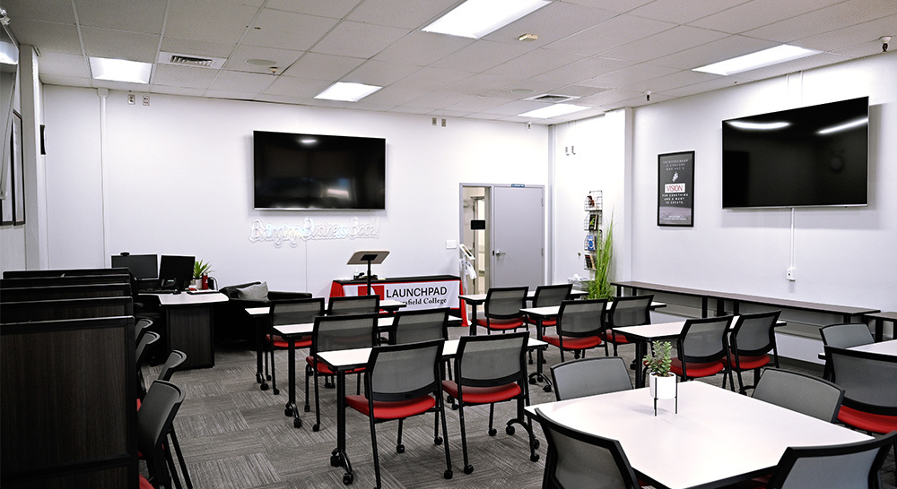
ENTREPRENEURIAL
HUB
FREE MEETING SPACE
01
Scanners, Printers, Wi-Fi
Presentation Equipment - HDMI/VGA Adapters
02
Phone Chargers - Iphone and Android
Headphones - For Use at the Hub
03
Computer Mice - Available for Laptops
Microsoft Office, Adobe Photoshop, and other Software

Slide 8
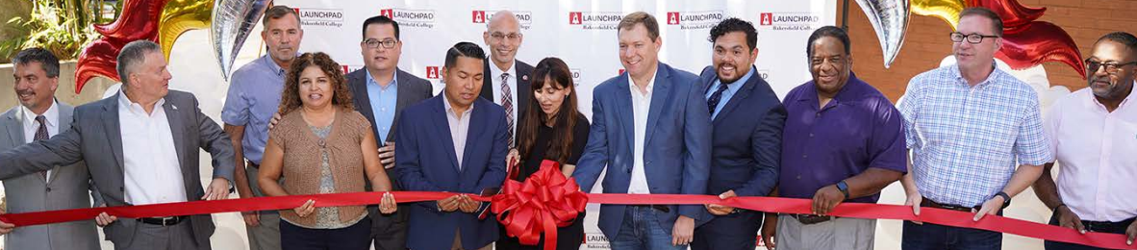



OUR COMMUNITY PARTNERS
With the help of community partners that have the same goal in mind, the Launchpad has the resources to help and guide entrepreneurs to the right location. If the Launchpad does not offer what you need, we can find one of our community partners that does.

Slide 9

2022-2023
PROGRAM
HIGHLIGHTS

Slide 10

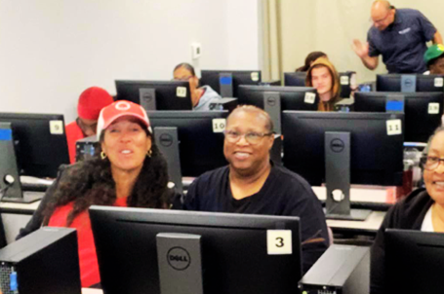
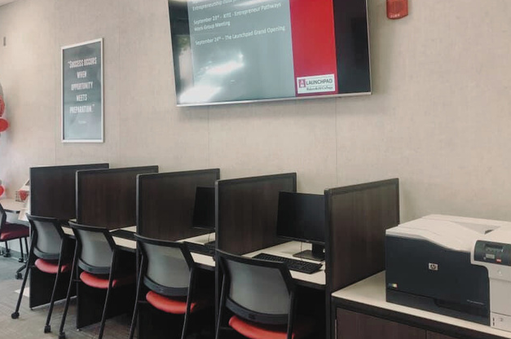
2022-2023
Redefining the Odds.
Here’s a look into how the BC Launchpad is fueling local entrepreneurship.
PROGRAM HIGHLIGHTS
376
87
37
Student Enrollment
course
sections
launchpad
tours

Slide 11

ENROLLMENT
HIGHLIGHT
Here’s a look into how the BC Launchpad is fueling local entrepreneurship.
Summer 2022
Fall 2022
Spring 2023
Summer 2023
Fall 2023
44
89
-
61
169
Total Student Enrollment
Total Student Enrollment
Total Student Enrollment
Total Student Enrollment
Total Student Enrollment
13
18
26
6
24
Course Sections Taught
Course Sections Taught
Course Sections Taught
Course Sections Taught
Course Sections Taught

Slide 12
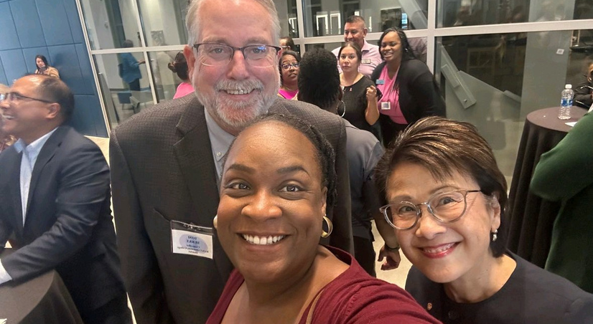
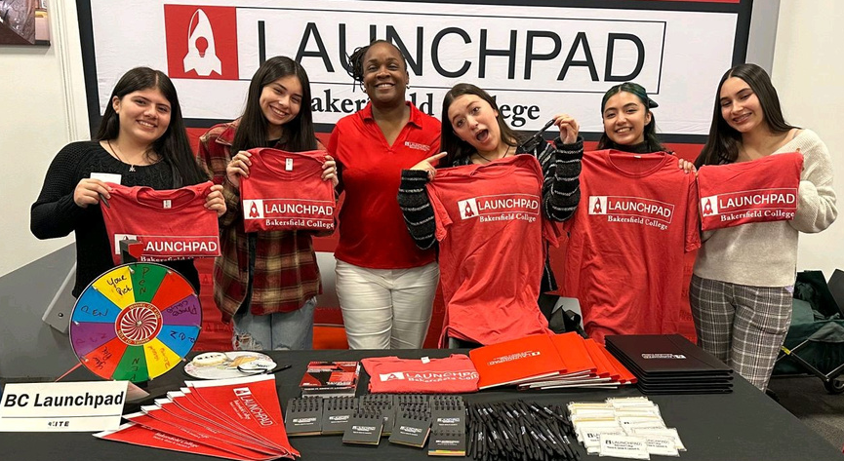
COMMUNITY
HIGHLIGHT
01
Conducted outreach efforts at various high schools and community events
02
Participated in Principal Partner’s Day at ROC/CTEC representing BC Launchpad
03
Attended STEMPosium and KC Career Expo to conduct outreach to high and middle school students
04
Showcased Launchpad program at the College Night at Mechanics Banks with a vendor booth
05
Hosted ROC & CTEC Entrepreneurship Launchpad Summer Camp / Kern Community Foundation

Slide 13
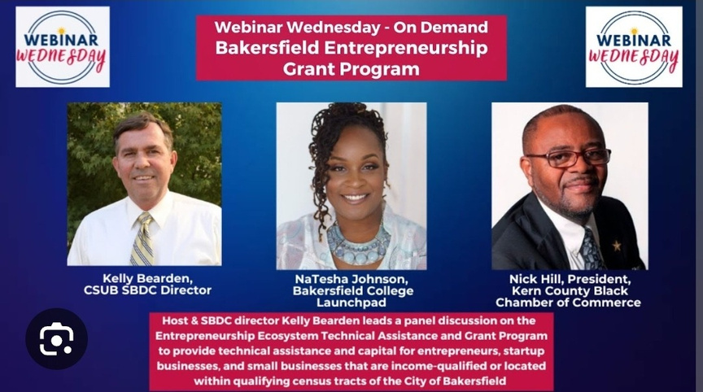
MEDIAHIGHLIGHT
01
BC Launchpad featured in 8 radio and television interviews.
02
Featured on CSUB SBDC “Webinar Wednesdays” and multiple podcasts.
03
Media efforts have improved Launchpad’s position as a go-to resource for small business owners.

Slide 14

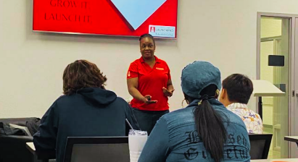
HIGHLIGHT
GRANT
City of Bakersfield Entrepreneurship Ecosystem Technical Assistance Grant
01
In April 2023, the Launchpad secured $350,000.
Grant offers financial assistance to entrepreneurs, startups, and small businesses within the City of Bakersfield.
02
$170K
03
In July 2023, the Launchpad initiated the grant program.
04
Collaborated with sub-providers to deliver technical assistance to businesses disproportionately affected by the COVID-19 pandemic.

Slide 15
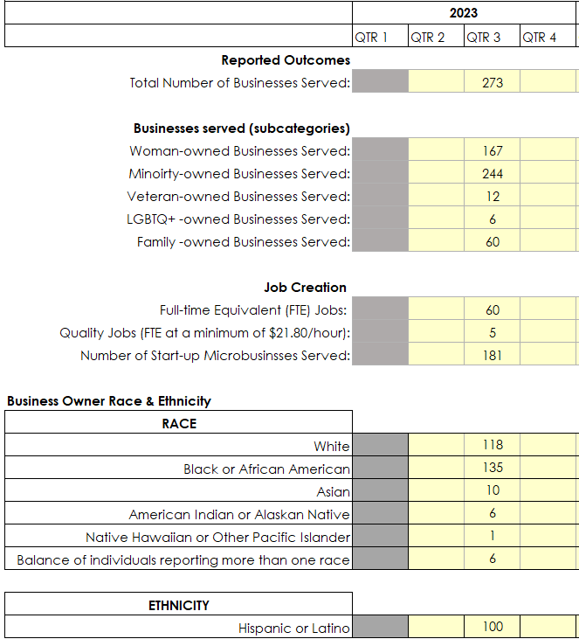
HIGHLIGHT
GRANT
City of Bakersfield Entrepreneurship Ecosystem Technical Assistance Grant

Slide 16




LOOKING FORWARD
Exciting times lie ahead!
We are committed to fostering the entrepreneurial spirit of Kern County and can't wait to see what the future holds.
2023-2024
Launch and Learn
Launchpad quarterly
startitup app
01
02
03

Slide 17


Slide 18

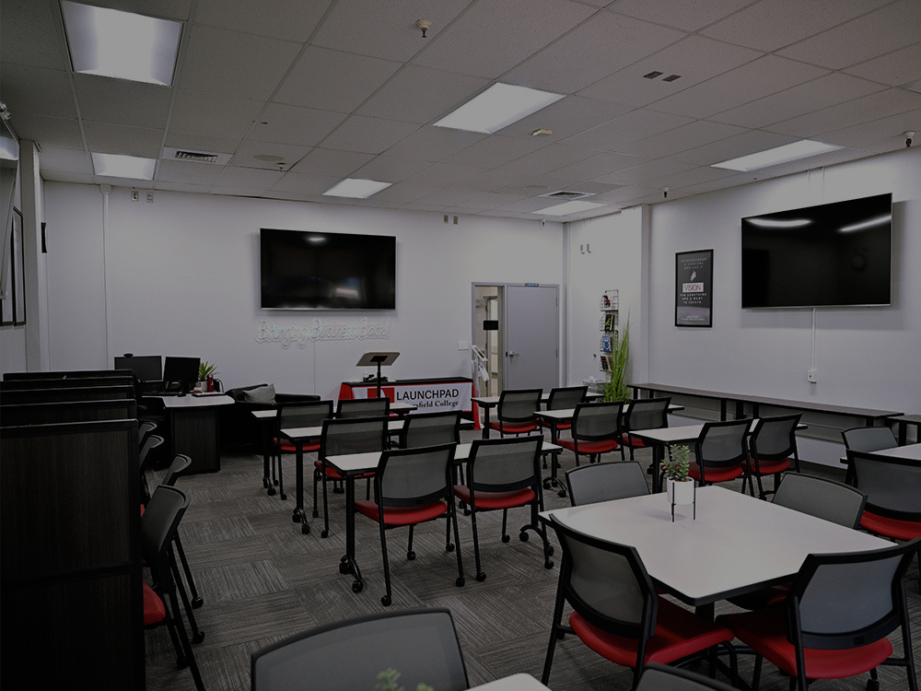
WE ARE
GROWING THE ENTREPRENEURIAL COMMUNITY UPWARD
THANK YOU

