Slide 1
COVID-19 Team Updates
4/11/22
https://docs.google.com/presentation/d/1VUlg8DFuighVcgNxMS8_dhOwCUkDDsGI8boRln4lpiU/edit?usp=sharing

Slide 2
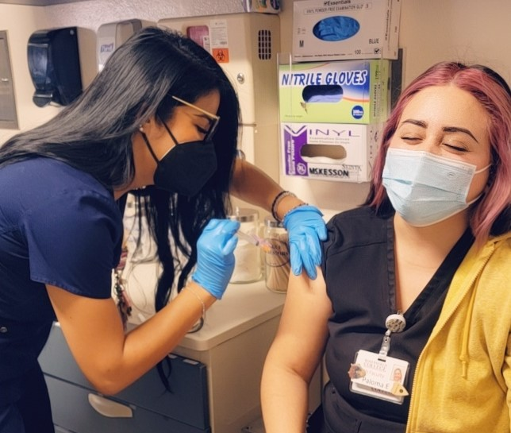
BC Interventions & California Pandemic Plan
BC Interventions
In-Person Commencement!
COVID Services in Levinson Hall
COVID Hotline
Student and general questions
DO for employee and work questions
Services
RN on duty
COVID vaccines (all approved)
COVID testing
KN-95 (highly recommended) and surgical masks
Contact tracing

Slide 3
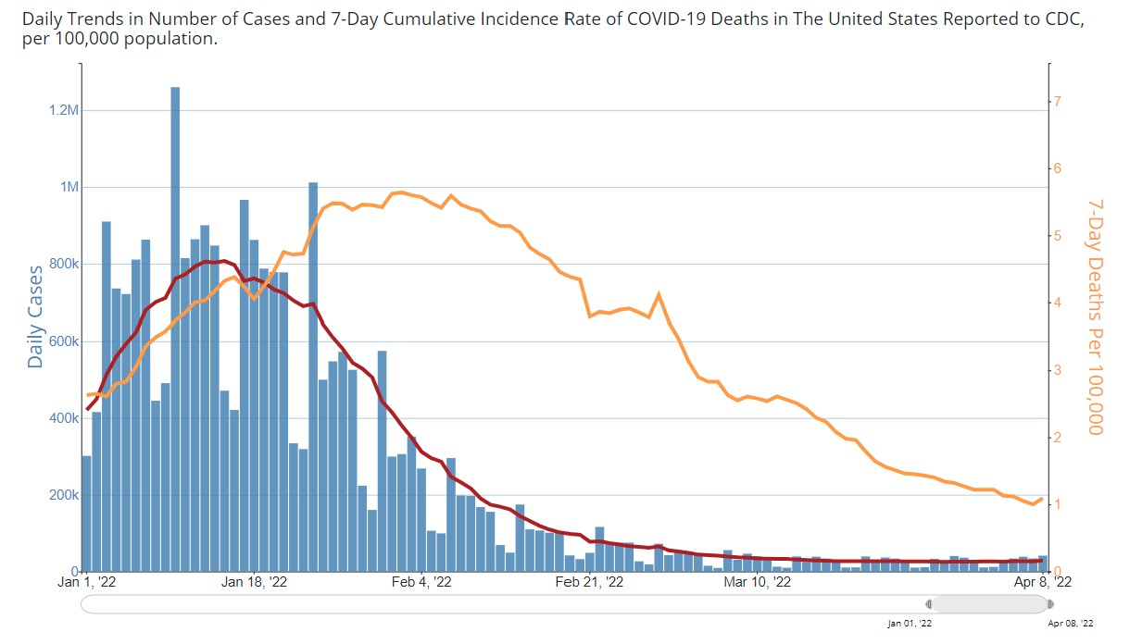
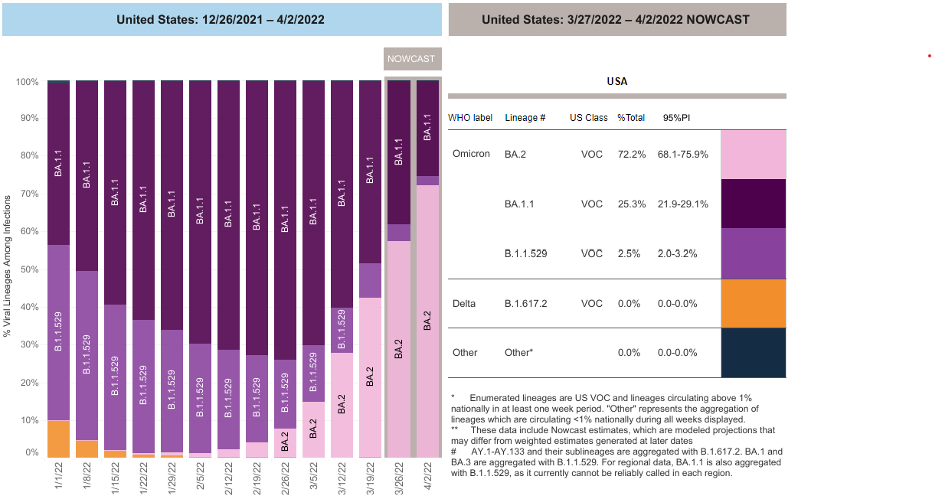
CDC COVID Surveillance
Notes:
**Slide with animations**
**Click
The Omicron variant has surged and is at a nadir.
Overall infections remain relatively low nationally.
**Click
Omicron BA.2 is increasing in proportion to other variants
This is happening while overall infections are not increasing
BA.2 is good at outcompeting its genomic brothers, but not at causing an increase in overall infection

Slide 4
30 Day Positivity Rate: 0.4%
(Ending April 10)
Point (Daily) Positivity and Volume (Daily) Over Time (YTD)
Notes:
30 day positivity rate continues to decline.
End of last week it was 1.6%
This week it is 1.4%

Slide 5
Takeaways
COVID Surveillance
Infection rates remain low
BA.2 is fighting for share of non-expanding pie
COVID Response
No change in services provided
Location change: Lev Hall
COVID-19 team continues to monitor situation

