Slide 1
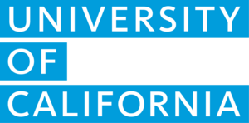
Program Pathways Mapper: An Intersegmental Pathways Solution
to Advance Transfer & Degree Completion with Equity

Slide 2
Everything you always wanted to know about the Program Pathways Mapper
Program Pathways Mapper 101: An Overview
Increasing STEM Student Flow in the Central Valley
Working with UC Merced, Merced College, & Bakersfield College
A technology of collaboration
Where we are today
Possible funding in the state budget for scale up
Sharing about the PPM’s value and building support

Slide 3
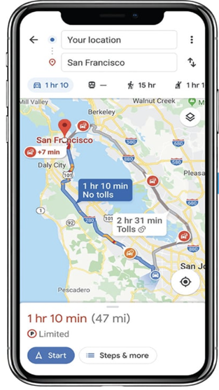
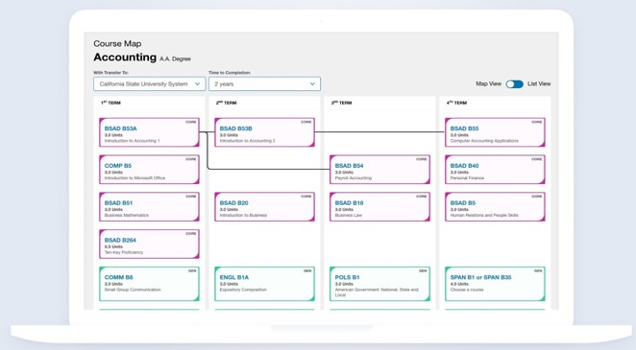
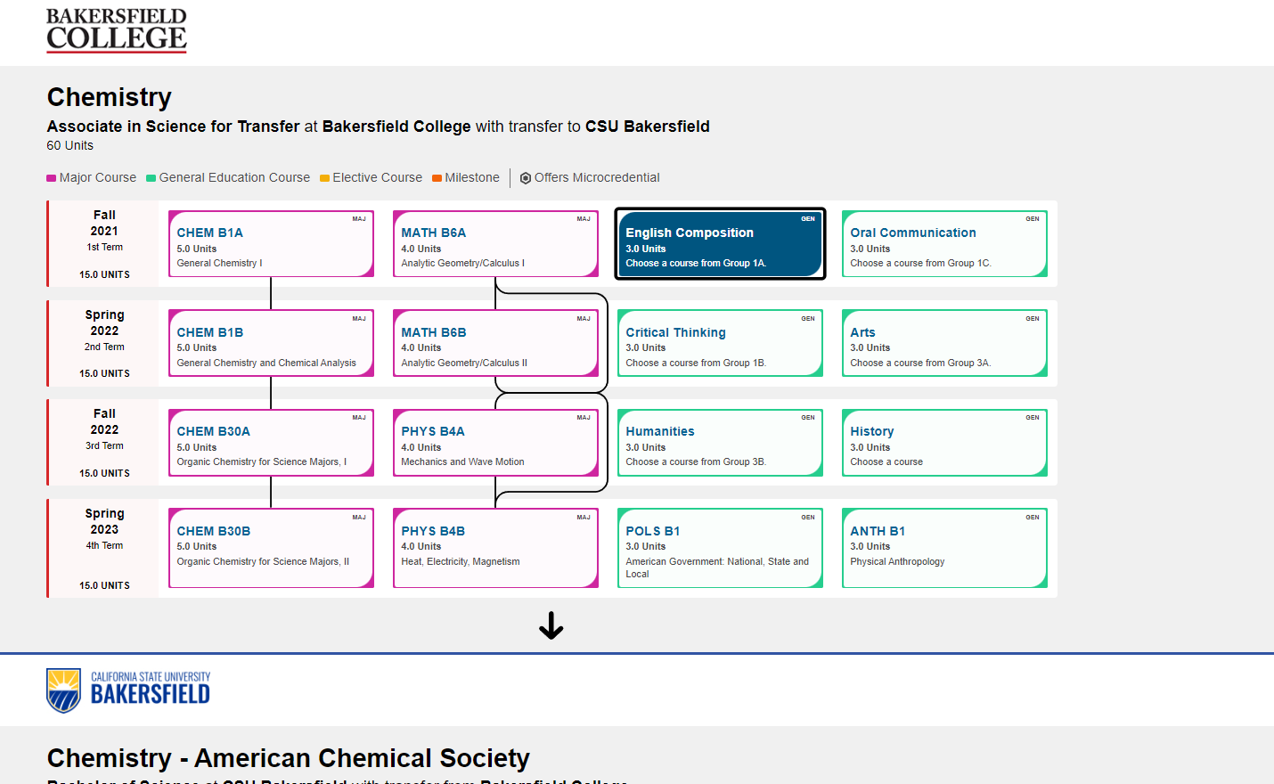
What Is Program Pathways Mapper?
PPM is a tool that creates interactive, pathway-based visualizations. Similar to a GPS mobile app, PPM displays a term-by-term course map that any student can follow to complete their desired program, either at the community college, at the university, or at both, as a transfer student.
Program Exploration:
Students are able to learn about academic programs in the context of expected employment outcomes or desired areas of study.
Academic Planning:
Each academic program features a term-by-term plan that displays all general education and major requirements. Intersegmental maps clarifying the pathway to the Bachelors for transfer students have been developed by six CSUs and one UC so far, with more to come.

Slide 4
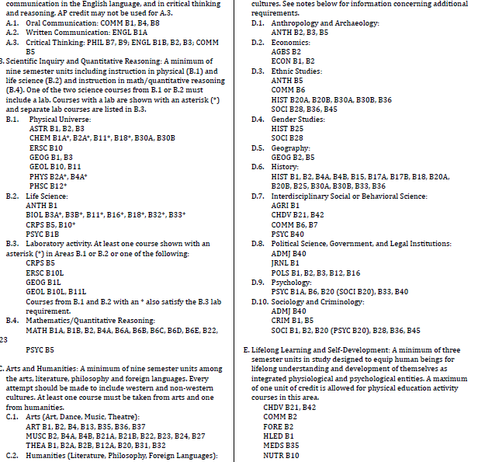
What Students See Now →
Cognitive Overload!
Notes:
Choice architecture – based on classic research study by Iyengar & Lepper (2000) in which students who had watched “Twelve Angry Men” as part of a class had the option to write a short essay about the film for extra credit. Some students were given 30 possible prompts to choose from, while other students were given 6 possible prompts. What do you think happened? 74% of the students who had six prompts to choose from completed the extra credit assignment while only 60% of those who had 30 prompts to choose from opted to participate. Moreover, students from the limited choice condition actually performed slightly but significantly better.
GP Conclusion: We need to provide default program maps that cuts through the catalog craziness, transforming the catalog into something that is easy to understand…

Slide 5
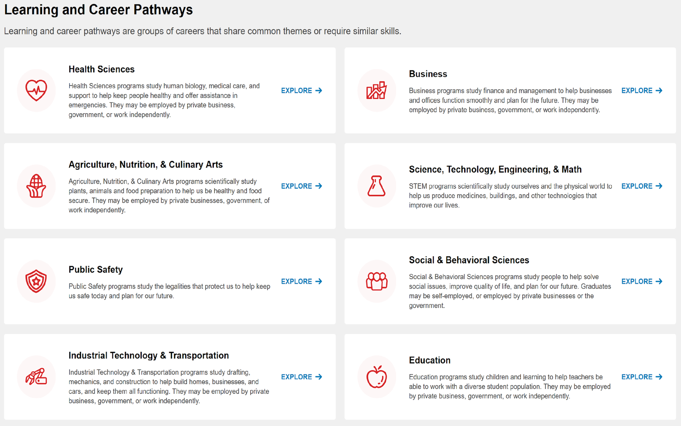
What students (and everyone else) SHOULD see:

Slide 6
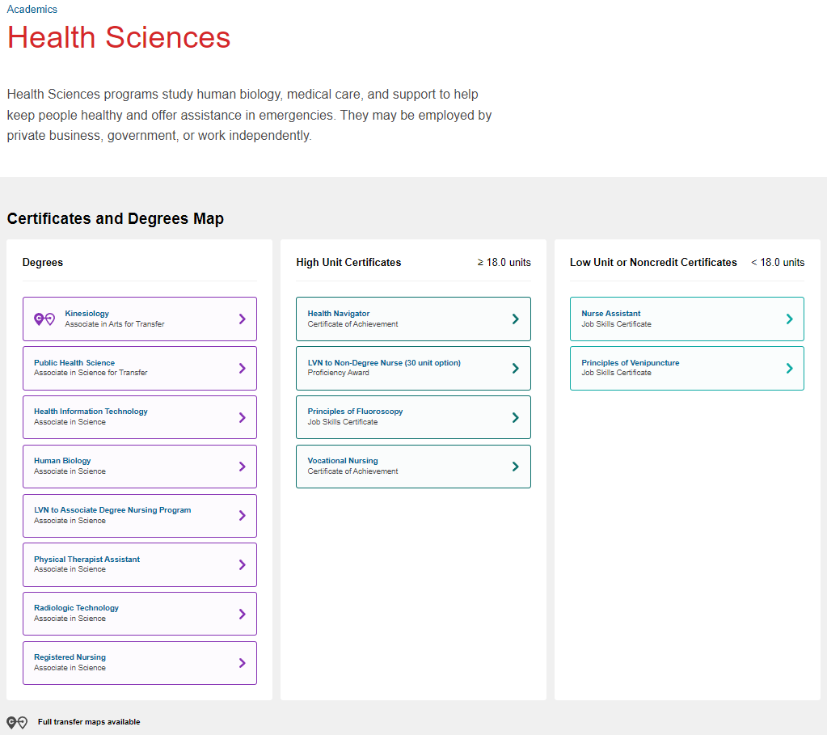
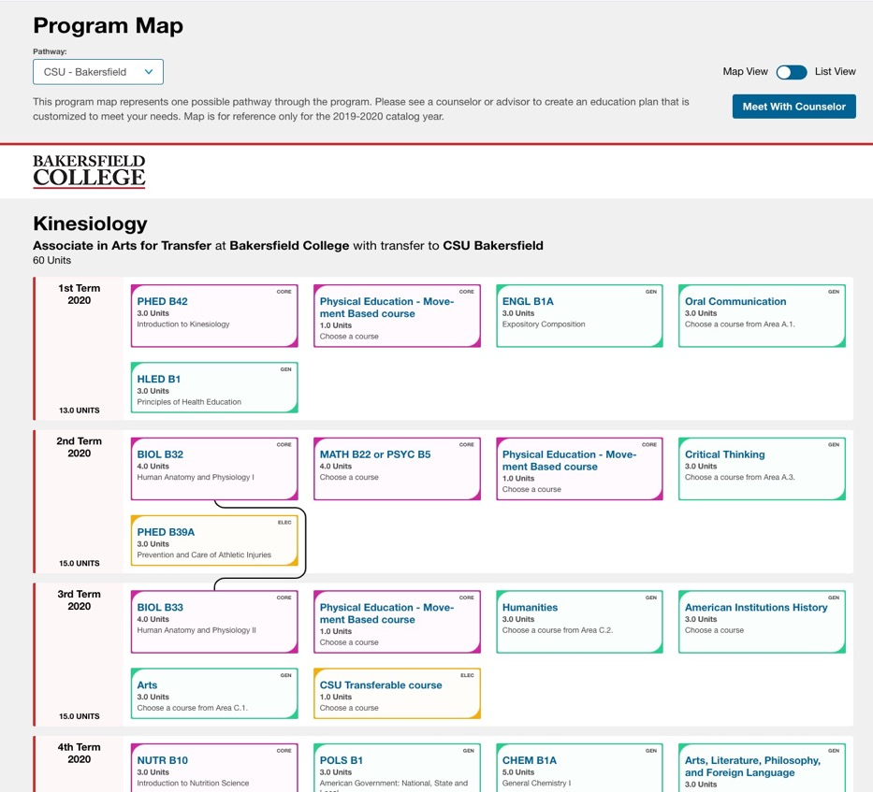
An intuitive interface that clarifies program and course selection:

Slide 7
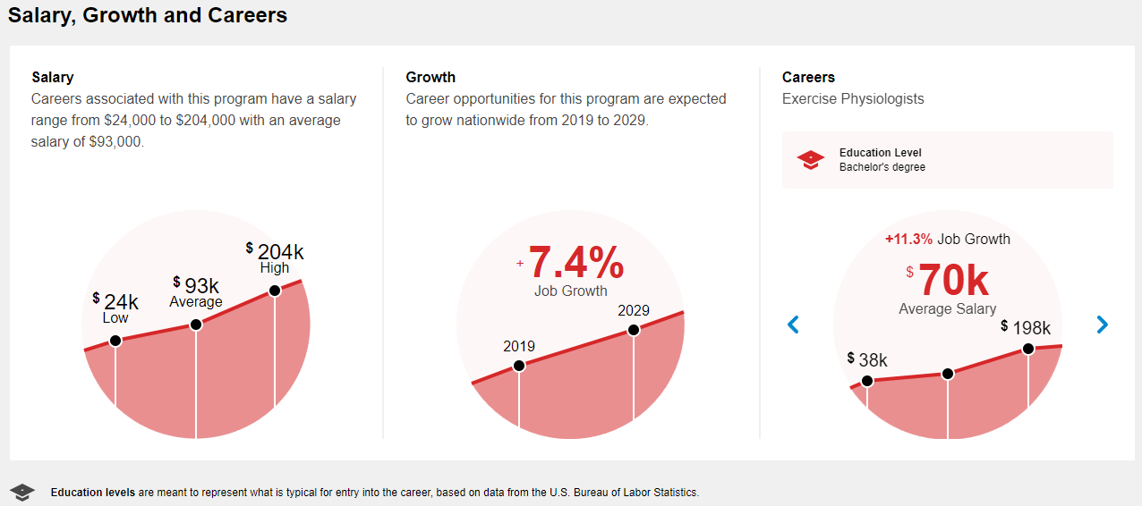
Regularly updated labor market data from the Bureau of Labor Statistics in addition to visual course guide.
Information about how programs connect to careers and wages

Slide 8
A variety of tools can help students, but the journey starts with Program Maps
Program Mapper
Explore
Clarify
Ed Planner
Select
Register
Degree Audit
Verify
Correct course
Engage
Personalize
Graduate
Easy access for prospective students & adult learners
Just-in-time class enrollment guidance
Useful outreach & orientation tool
Guide students while social distancing
Notes:
The PPM also reaches beyond the degree audit to clarify the path to completion of the Bachelor’s degree in a way that is powerful for students and completely unique.

Slide 9
PPM’s value proposition for State priorities
Reduce excess unit accumulation
Shorten time to completion
Increase # of transfer students / efficiency of transfer
More baccalaureate completers
to meet California’s
growing labor demand
9
Notes:
The slide deck provides three levels of detail from novice being at level 1 and expert at level 3. Level 1 - answers the why? and what? Level 2 - answers why? what? how? and Level 3 - why? what? how? and financial analysis for how much investment for scaled implementation.

Slide 10
PPM’s value proposition for students
What students are saying about PPM
[Program Mapper] puts you at ease as a college student, like, okay, this is what I need to do. This is what has to happen next. . . .[I like] just how simple it is and how organized it is. I think that's my favorite part.
The salary growth and career section helped me to get a stepping-stone into researching more specifics about what I wanted to start a career in.
It's really useful to figure out which [classes] can transfer over into your certain area to the certain [transfer destination] because you don't want to take a class that's not going to mean anything.
If you follow Program Mapper or the pathways, you probably could have gotten everything out of the way and then been done on time. . . So it helps you with efficiency and being clear about how to get out as quickly as possible.

Slide 11
Evidence of PPM Effectiveness Student Course-Taking Becomes More Focused
Source: Bakersfield College
Notes:
Ultimately, increasing OPP will result in more students graduating and more students graduating more efficiently.

Slide 12
Evidence of PPM Impact on Equity The PPM has already advanced the equity agenda
Source: Bakersfield College
Notes:
Among students pursuing an ADT, White students increased their on-path percentage by 11 percentage points while Black students increased by 15 percentage points and Latinx students increase by 18 percentage points.

Slide 13
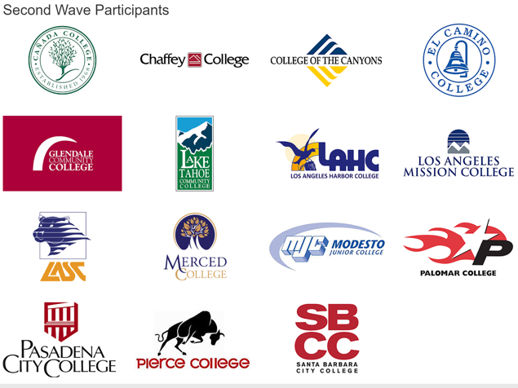
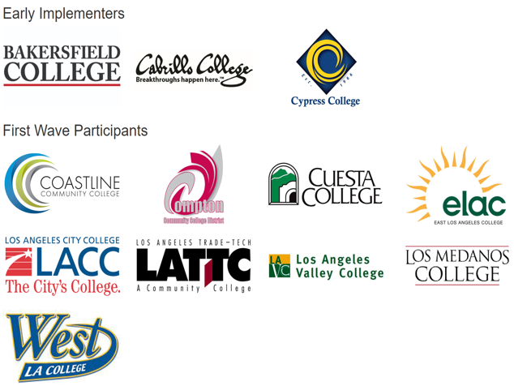
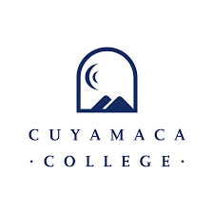
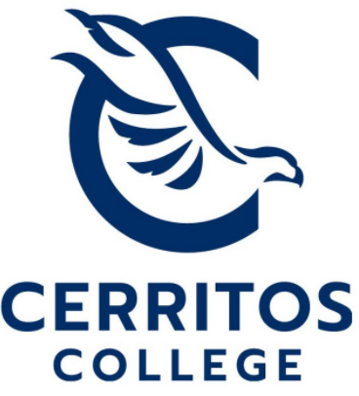
Current PPM Reach
We’ve been doing this work for years and are poised to scale statewide
Early Implementers
Second Wave Participants
Institutions | Student Population
42 CCCs | 942,283
6 CSUs | 102,106
1 UC | 8,151
TOTAL | 1,052,540
Third Wave Participants
CSUs
UC
Notes:
This is a tool that a lot of higher education is already embracing. It ties us closer together.
This is becoming the way we are do business in California
Regional opportunities & rural impact → equity outcomes

Slide 14
Thank You!
Craig Hayward Craig.Hayward@bakersfieldcollege.edu
@doc9x
Sonya Christian
Sonya.Christian@kccd.edu
@sonyachristian
Notes:
Whose contact information to include?

