Slide 1
Using Good Data to Keep BC Safe

Slide 2
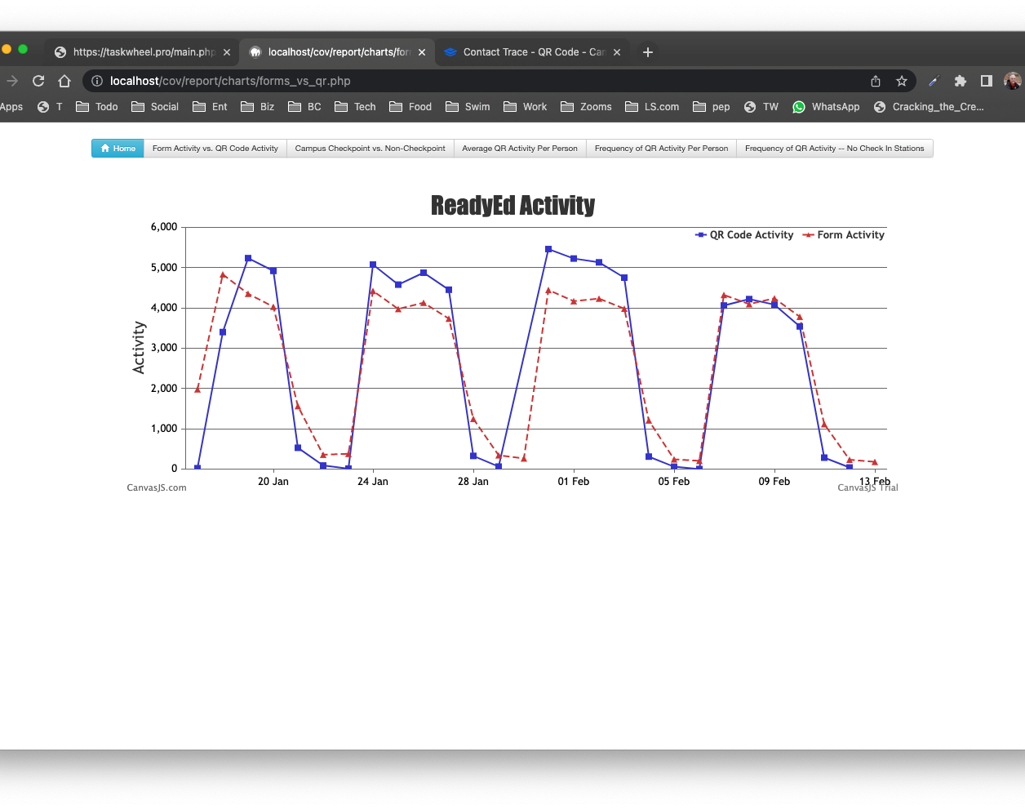
ReadyEd Activity
QR Code Activity
Form Activity

Slide 3
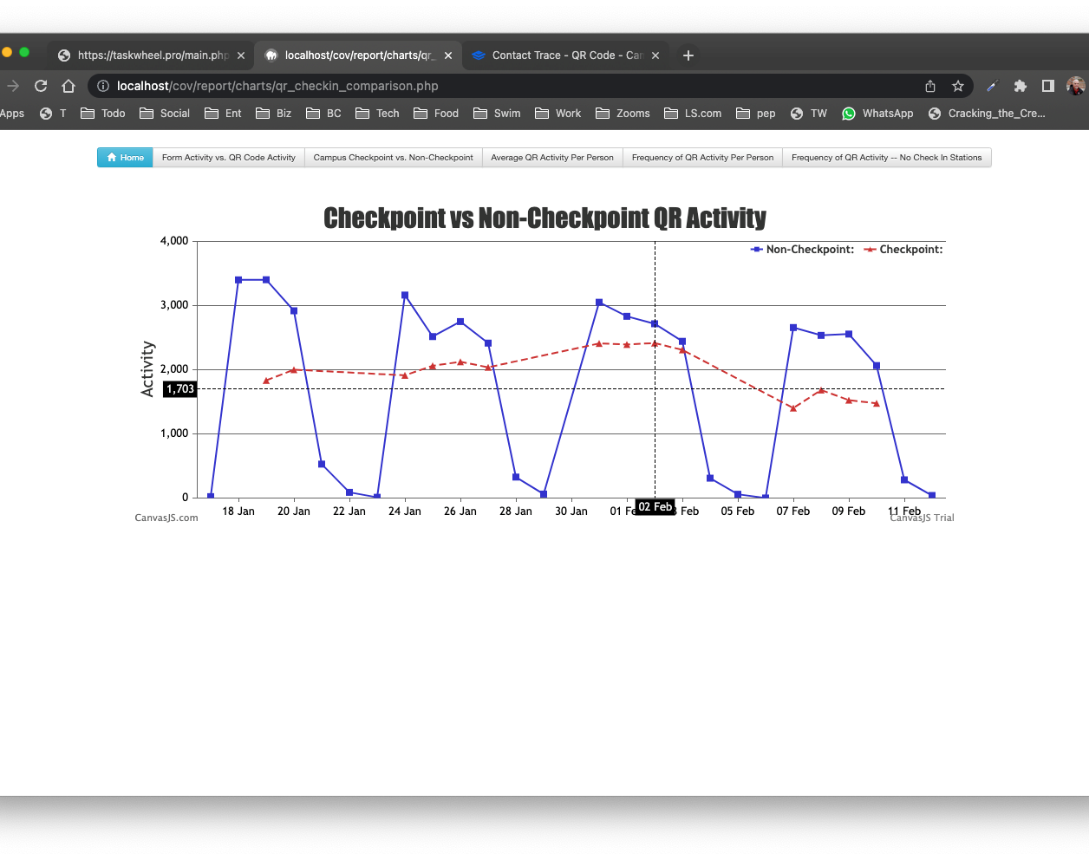
Checkpoint vs
Non-Checkpoint QR Activity
Non-Checkpoint
Checkpoint

Slide 4
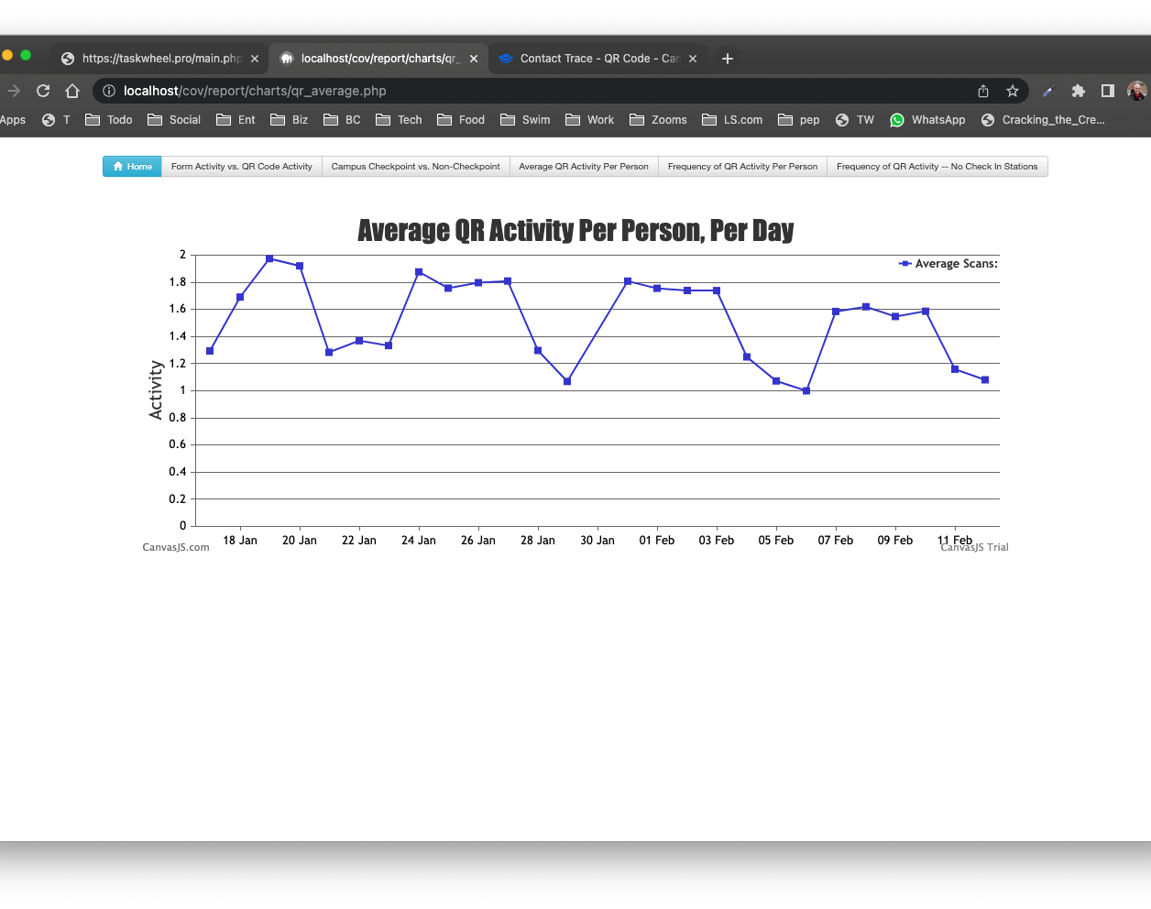
Average QR Activity Per Person, Per Day
Average Scans

Slide 5
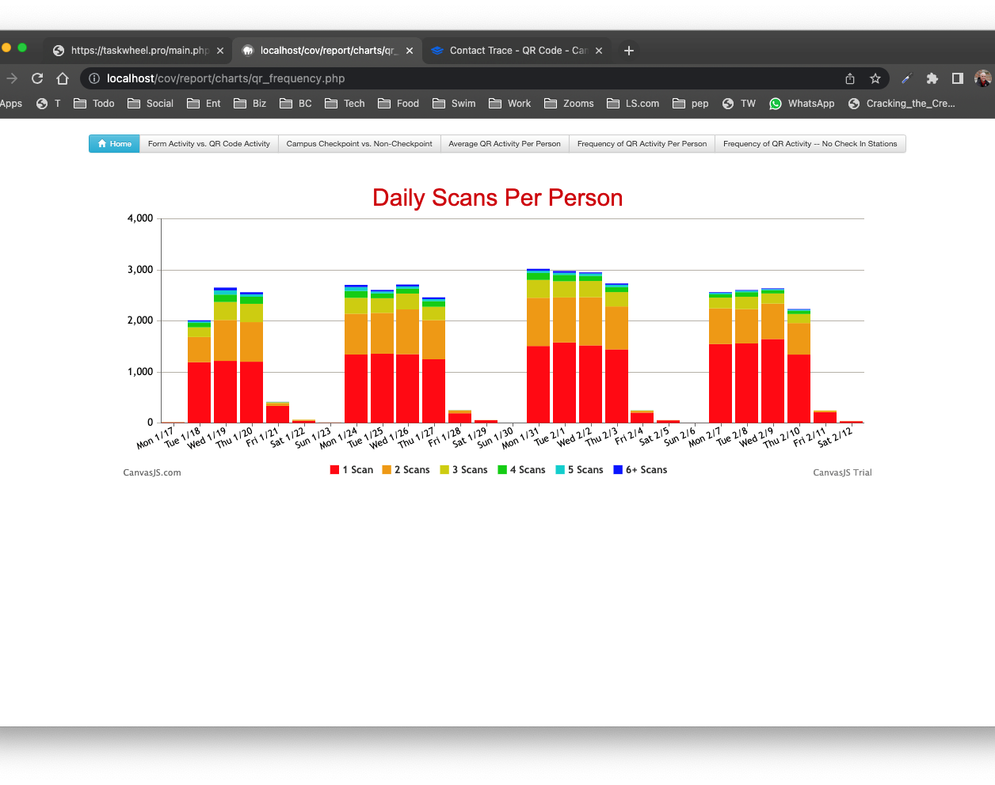
Daily Scans
Per Person
1 Scan
2 Scans
3 Scans
4 Scans
5 Scans
6+ Scans

