Slide 1
COVID-19 Team Updates
https://docs.google.com/presentation/d/1VUlg8DFuighVcgNxMS8_dhOwCUkDDsGI8boRln4lpiU/edit?usp=sharing

Slide 2
Four Principle Interventions
Vaccination
Jabs available in Fireside Room
Moderna, J&J, Pfizer peds & adult
Contact Tracing
COVID-19 team will reach out with standardized instructions
Masking
KN-95 masks available in Fireside Room
RNs available to assist with proper fitting
Daily Health Checker
Check-In Stations: 0700 to 1300
Complete online or on phone

Slide 3
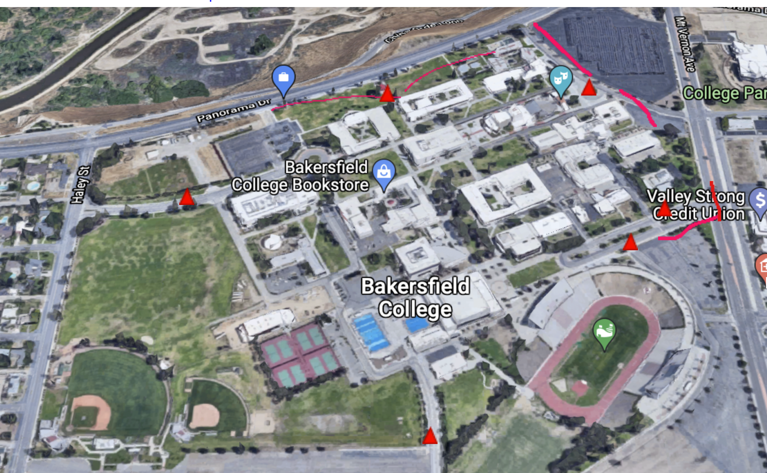
COVID Checkpoints

Slide 4
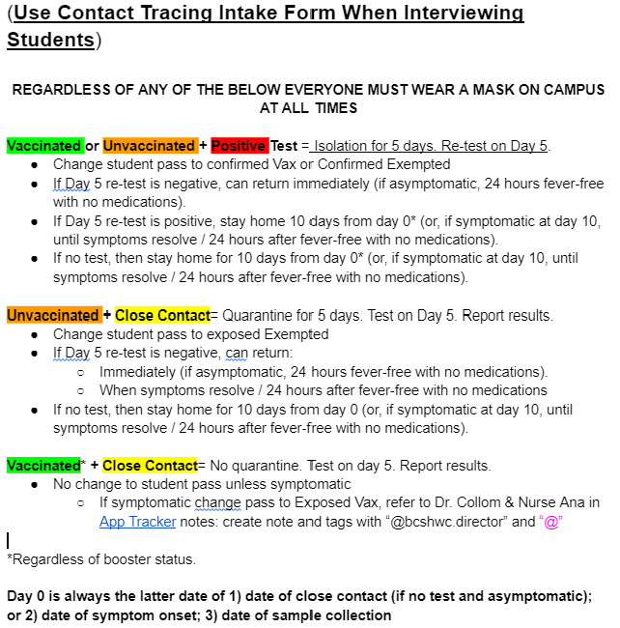
Return to Campus
A simplified version of Cal-OSHA’s algorithm.

Slide 5
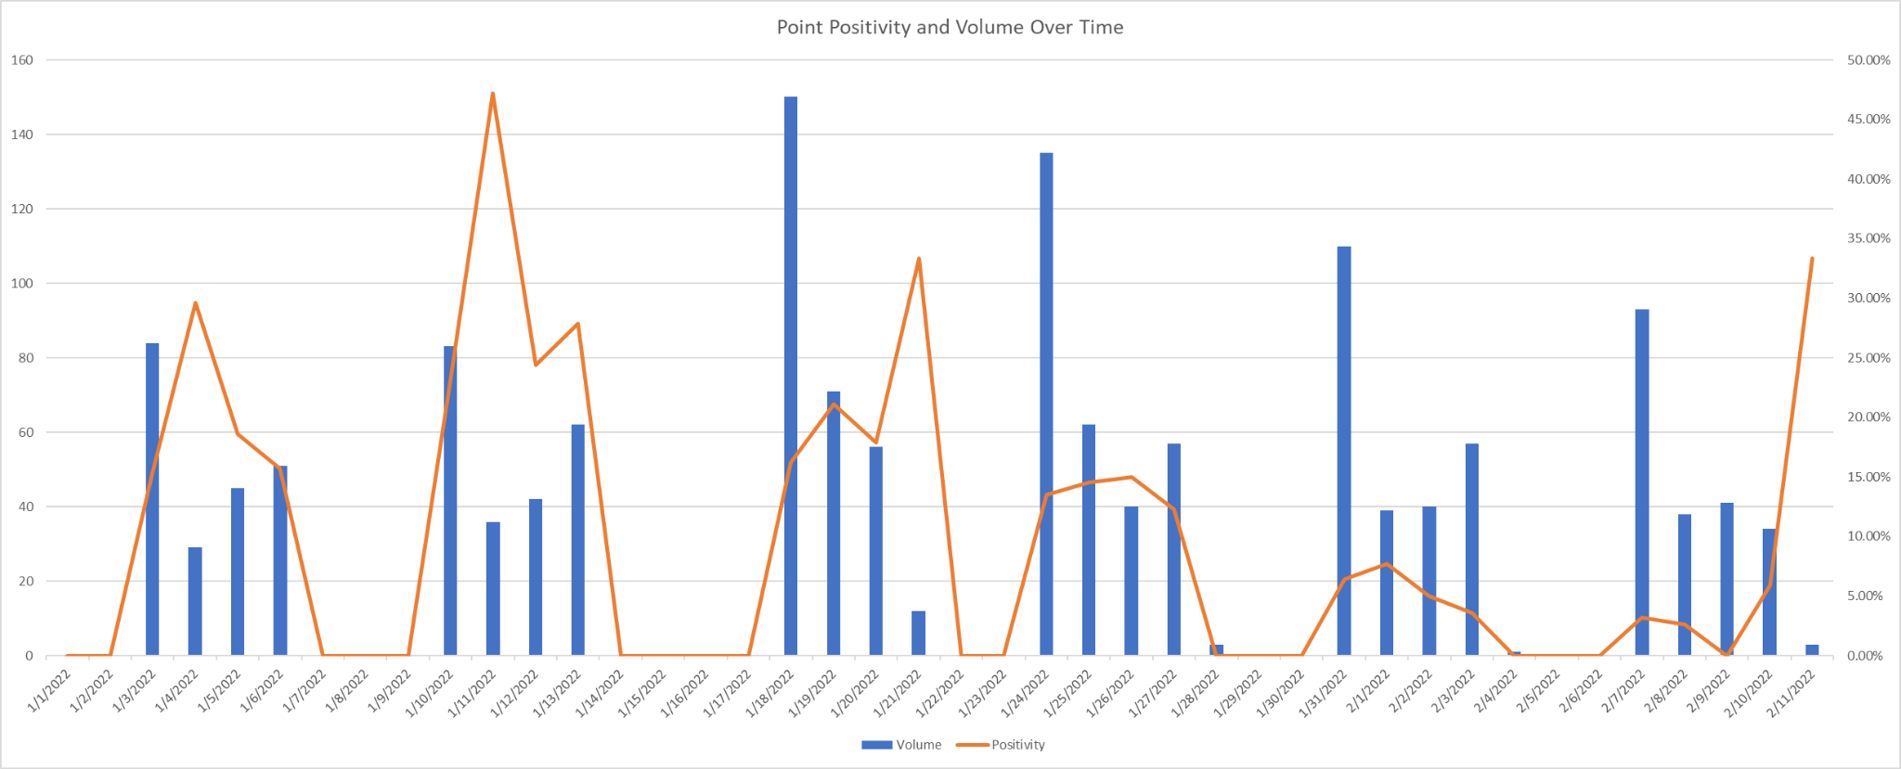
Point (Daily) Positivity and Volume (Daily) Over Time (YTD)

Slide 6
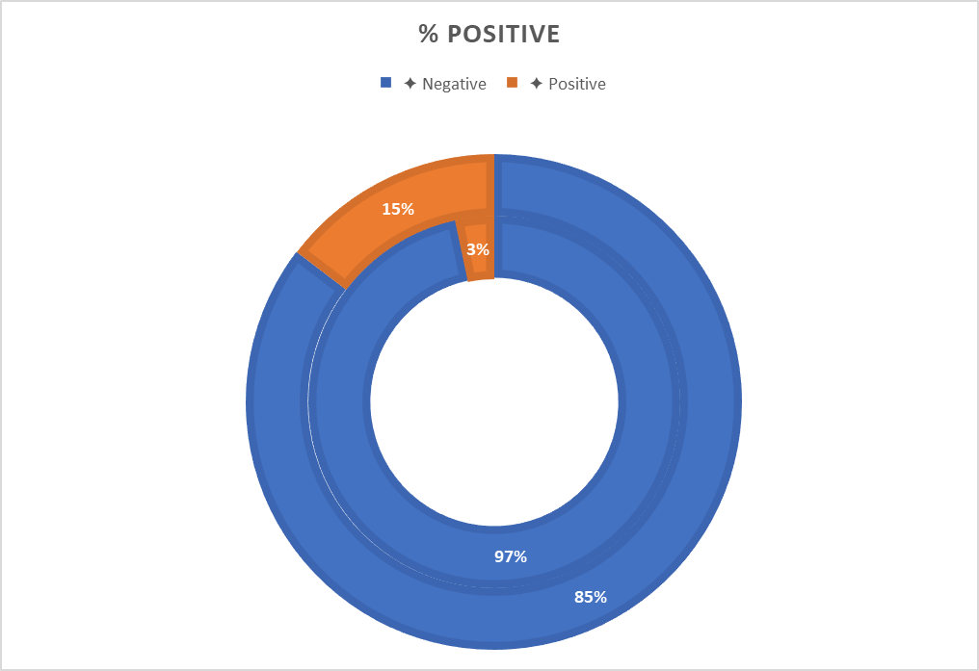
On-Campus Testing
Good News
7 positive tests in 7 days
208 tests total
Mindful News
90 days ago “Omicron” was not identified
Vaccination continues to be the best intervention to prevent serious illness / death

