Slide 1
AUO Planning Update 2021
Stephen Waller and Pamela Rivers
Oct. 11, 2021

Slide 2
Topics
ACCJC Standards
BC AUO Practices
BC’s Four AUOs
SLOs versus AUOs
Quantifying AUOs (draft)
AUOs in eLumen (a community college 1st!)

Slide 3
ACCJC Standards
Standard I.B
2. The institution defines and assesses student learning outcomes for all instructional programs and student and learning support services.
4. The institution uses assessment data and organizes its institutional processes to support student learning and student achievement.

Slide 4
BC AUO Practice
BC has complied with ACCJC standards by…
Establishing AUOs (Administration Unit Outcomes) that align with the College’s Mission and ILOs.
Reporting qualitative specific area AUOs in Program Reviews.
Creating four College-wide AUOs that map to the four ILOs and reporting these in Program Review starting 2019.
The College is now developing a new norm for AUO quantitative reporting to allow AUO data to match quantitative SLO data to have one ILO reporting for the entire institution.

Slide 5
Four Specific AUOs
AUO #1: Use efficient budgeting and categorical funding practices.
Maps to ILO 1: Think critically and evaluate sources and information for validity and usefulness.
AUO #2: Organize positive communications between the community, administration, faculty, staff, and students.
Maps to ILO 2: Communicate effectively in both written and oral forms.

Slide 6
Four Specific AUOs
AUO #3: Engage administrators, faculty, and staff in professional development.
Maps to ILO 3: Demonstrate competency in a field of knowledge or with job-related skills.
AUO #4: Develop internal and external partnerships that benefit the College.
Maps to ILO 4: Engage productively in all levels of society – interpersonal, community, the state and nation, and the world.

Slide 7
SLO versus AUO
 | SLO | AUO
Outcomes | Committees or C-ID | Four for all Admin
Data Collector | Individual Faculty | Individual Admin
Data Location | eLumen | Program Review
Data Reporter | Faculty | Admin
Data Type | Quantitative (% expectations) | Mostly Qualitative

Slide 8
Example Quantifying AUOs
This is a draft 1st attempt to establish quantification of AUOs following the same reporting as SLOs using % expectations. Define your own expectations!
Metrics as part of AUO 1 | Expectation
Oversaw a grant or restricted funds | at least one grant
Participated with writing a grant proposal | at least one grant
Received a new grant approval | at least one grant
Collaborated externally on a grant | at least one grant
Kept within GU budget | spent no more than allowed budget
Submitted GU budget request on time
Presented thoughtful GU budget justification

Slide 9
For Steve Waller 2019-20 Fiscal Year
Metrics as part of AUO 1 | Expectation
Oversaw a grant or restricted funds | Met
Participated with writing a grant proposal | Exceeded
Received a new grant approval | Met
Collaborated externally on a grant | Met
Kept within GU budget | Did not Meet
Submitted GU budget request on time | Met
Presented thoughtful GU budget justification | Met
87% Met or Exceeded

Slide 10
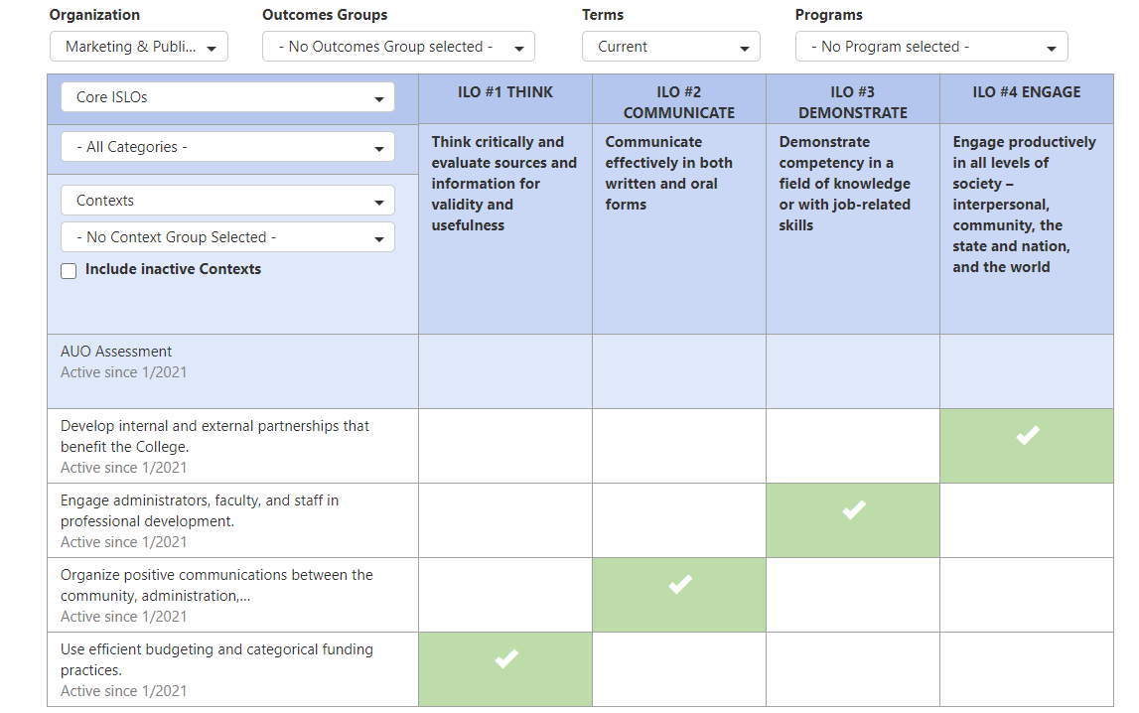
eLumen AUOs Mapping to ILOs

Slide 11
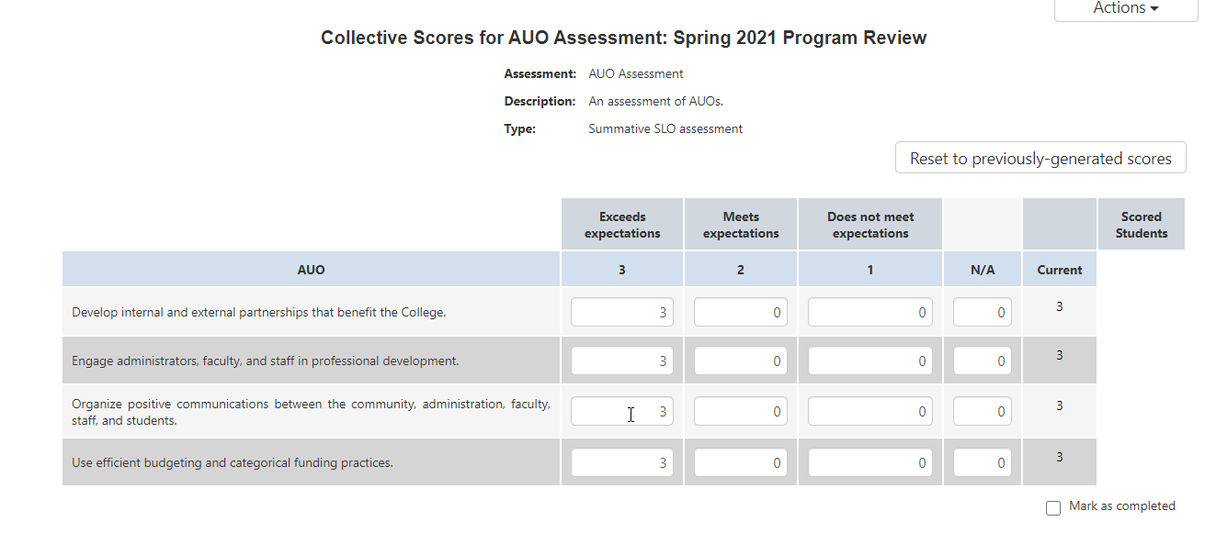
AUO Expectation Reporting by Admin Unit

Slide 12
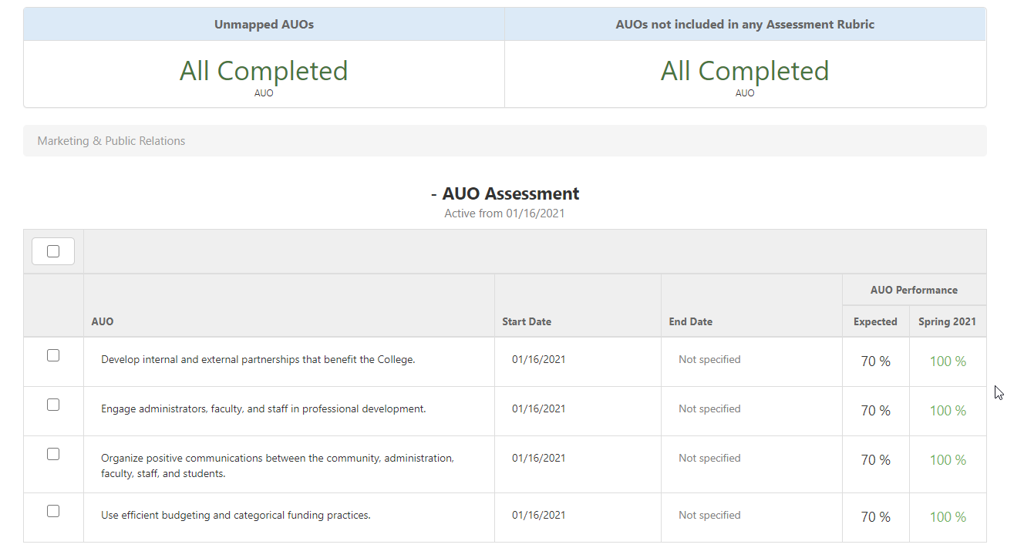
AUO Report with Performance Standards
70%

Slide 13
Questions?

