Slide 1
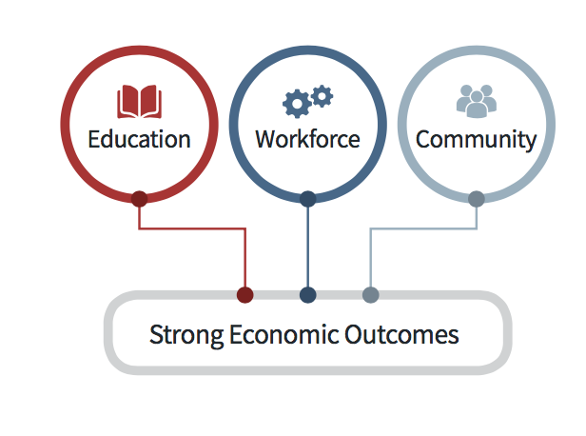
With Non-Credit
Skill

Slide 2
Attention Student employees!!
With tuition-Free Courses & Certificates
These short term, stackable courses & certificates are designed to skill up, build up & get you back to work or expand that resume
Back to College Webpage

Slide 7
WHO?
Currently enrolled BC Student employees
Why?
Opportunity to expand those skills sets
Great way to build up that resume
How?
Check out our Back to College Webpage
Our team is standing by to assist and one click away
Rural Virtual Lobby
Cost?
Free to register
Student health applies

Slide 8
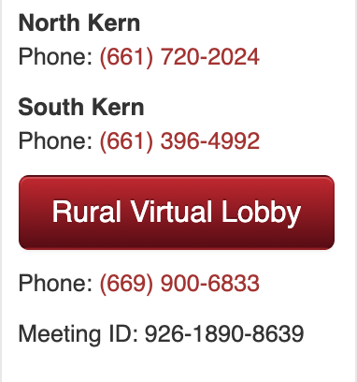
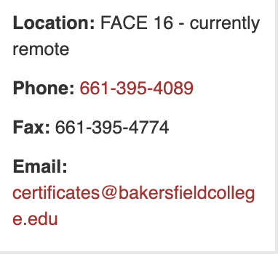
Contact us
Rural Virtual Lobby
Student Employment Virtual Lobby
Adult Education Webpage
Student Employment Webpage

