Slide 1
Adobe Sign Get Started guide

Slide 2
We will discuss:
Opening Adobe Sign
Setting Up Signatures

Slide 3
Opening Adobe Sign
Open your “Creative Cloud” desktop application

Slide 4
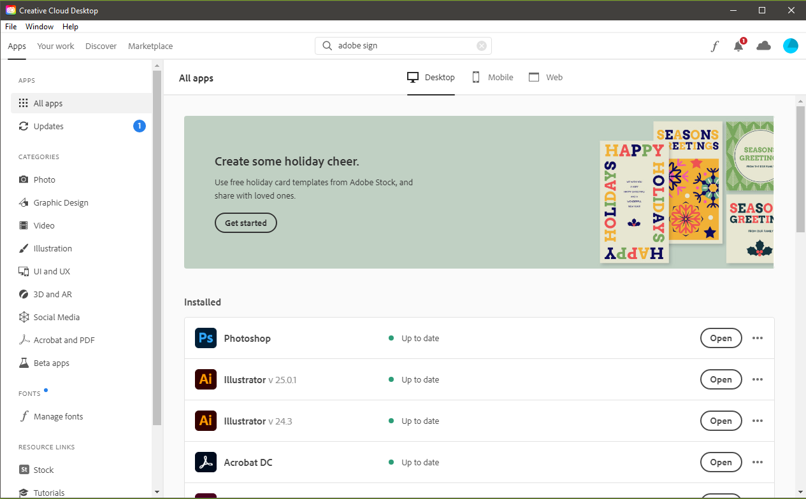
Opening Adobe Sign
Click “Web” in top navigation bar

Slide 5
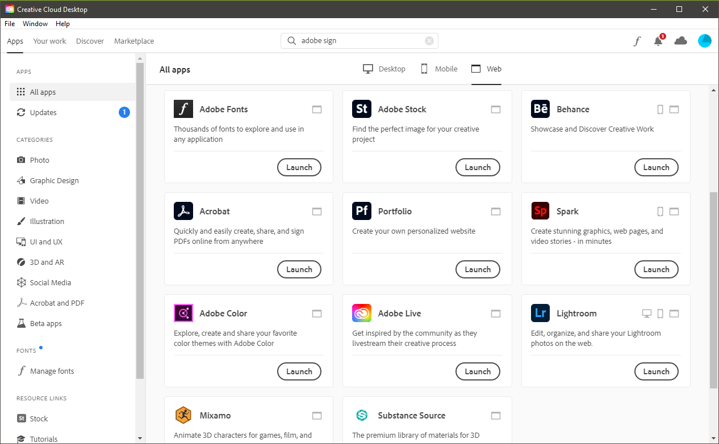
Opening Adobe Sign
Open the “Acrobat” application by clicking “Launch”

Slide 6
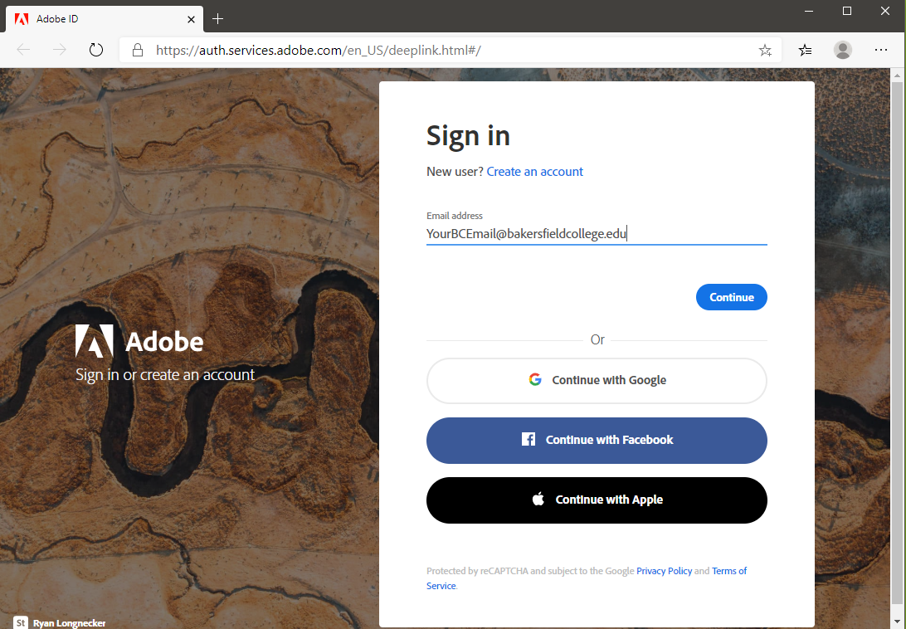
Opening Adobe Sign
Login to your Adobe account using your Bakersfield College email and password

Slide 7
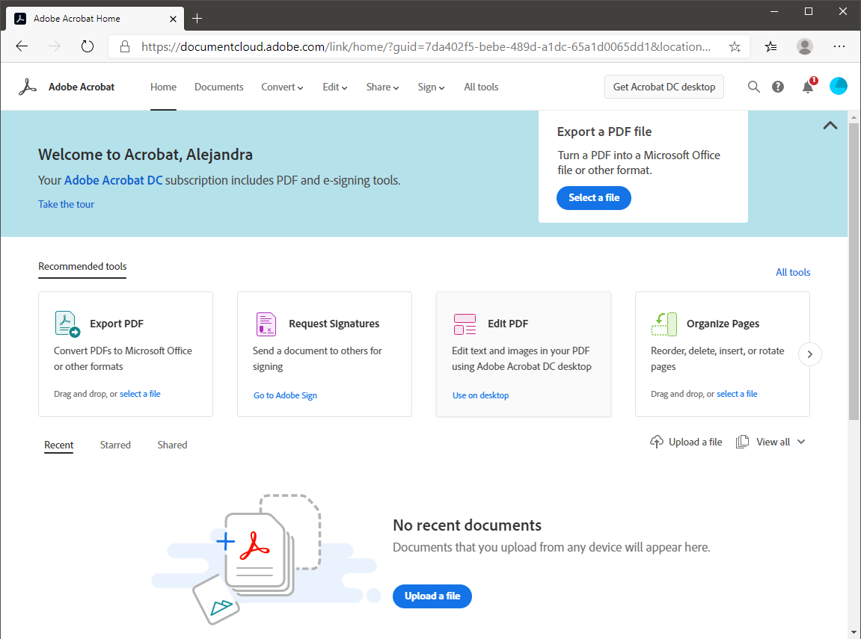
Opening Adobe Sign
Click “Go to Adobe Sign”
Note: Adobe may ask you to sign in again

Slide 8
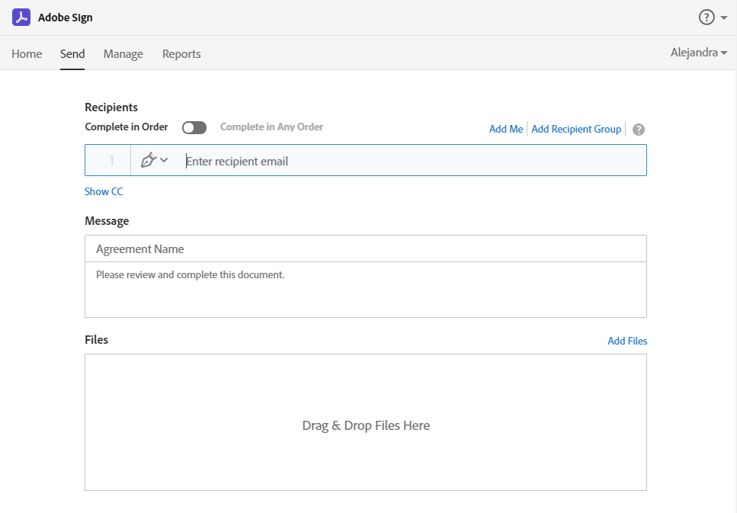
Toolbar
Home page – additional tools within Adobe Sign
Send – used to create new agreements
Manage – used to track, process, and customize agreements
“Send” will be the landing page once you log into Adobe Sign

Slide 9
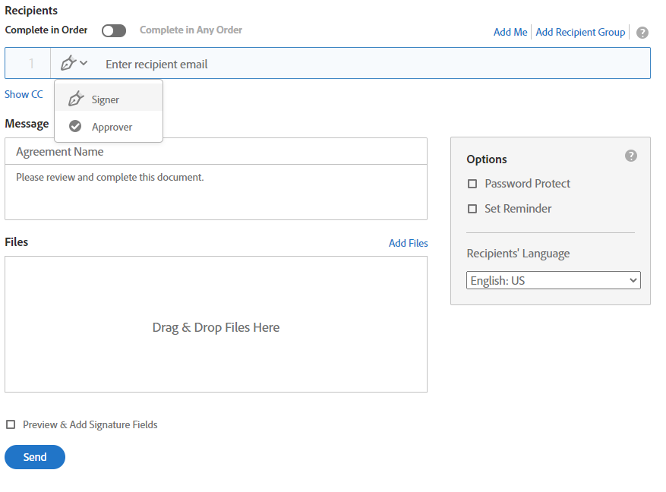
Agreement Functions & Terms
When setting up signatures, there are various functions.
Complete in Order is a sequential signing process where recipients are numbered to indicate the exact participation order.
When “Complete in Any Order” is enabled, recipients are not numbered and parallel signing can take place.
In Recipient Groups, any member in the group is authorized to sign or approve on behalf of the entire group.
A “Signer” is who you need to sign the document.
An “Approver” will not need to sign the document; however, they will need to review the document for accuracy before the next signer.

Slide 10
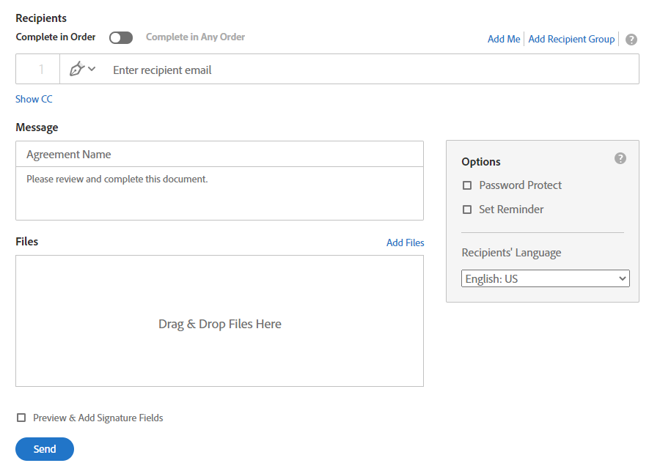
Setting Up An Agreement
Enter email address of recipient
Enter custom agreement name, and edit the message the recipient will see in the notification email
Choose the document you will have signed by clicking “Add Files” or by dragging and dropping into the box

Slide 11
Setting Up An Agreement
Optional
You will see several options on the right side of the window, such as:
Adding a password
Set reminders

Slide 12
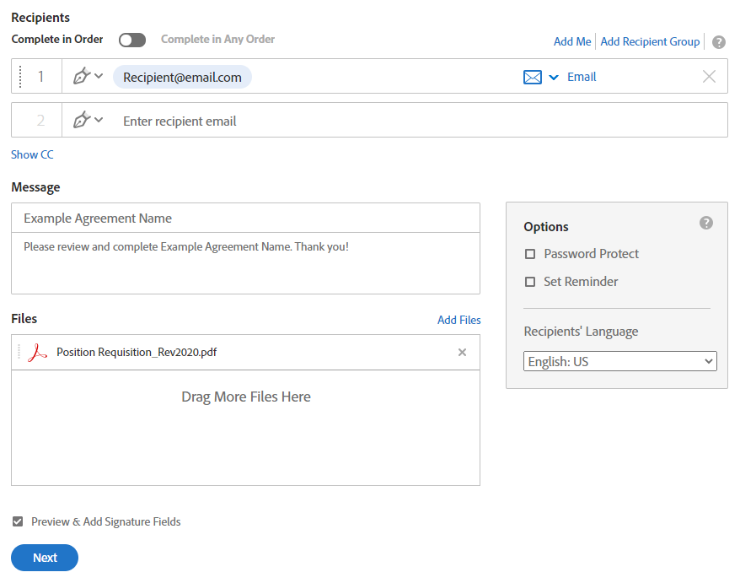
Setting Up An Agreement
4. Then check “Preview & Add Signature Fields”, then click “Next”.
This will prompt a document review before sending for signatures.

Slide 13
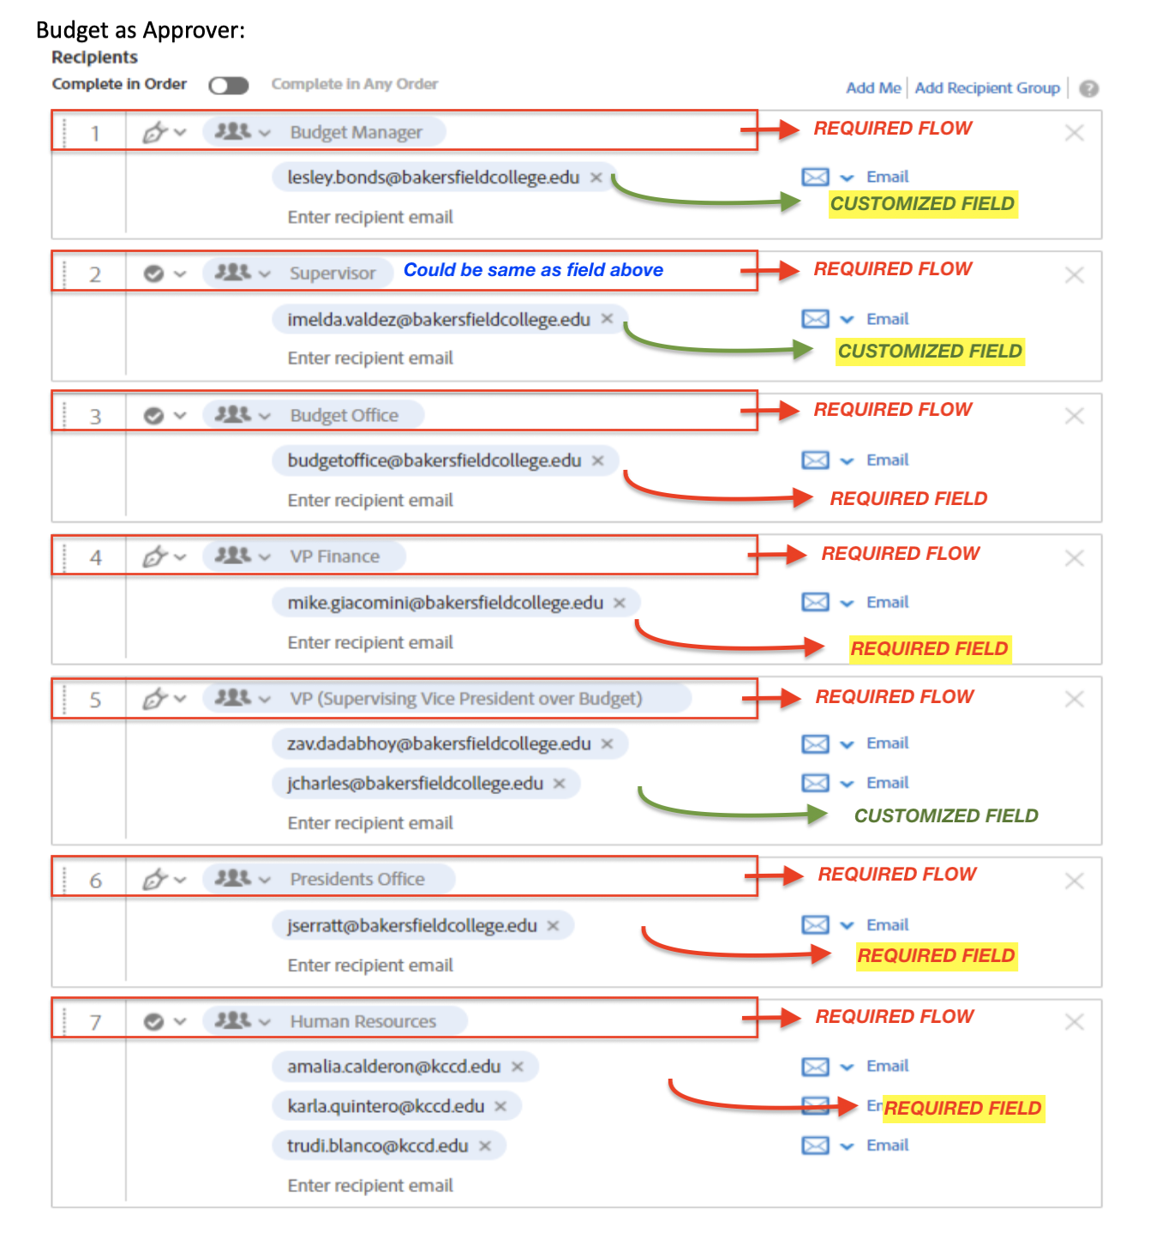
Position Requisition- HR Signature Flow Example
The customization is based on your budget supervision

Slide 14
Demo

