Slide 1
Admin. Council
October 14, 2019

Slide 2
We are moving!
Current Location:
11000 River Run Blvd #200, Bakersfield, CA 93311
(Corner of Buena Vista & Stockdale Hwy- FPU Building)

Slide 4
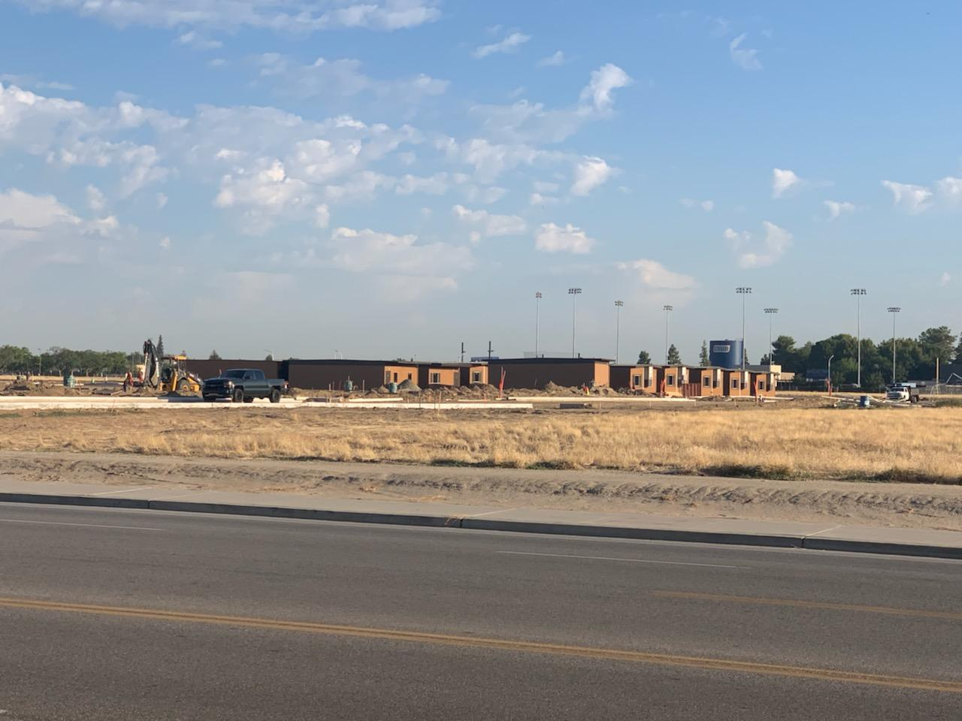
New Site Progress

Slide 5
Modular Map
Fall, 2019

Slide 6
Communicating a Smooth Transition
Email to all BCSW Faculty and FCDC: October 3rd
Lobby Distribution: Flyers and Maps of New Location
Updating Banner to show new location
Free Student Parking Permits
Instructors sharing details in classes
Coverage at both FPU and BCSW modular the week of the 21st
Websites & Social Media

Slide 7
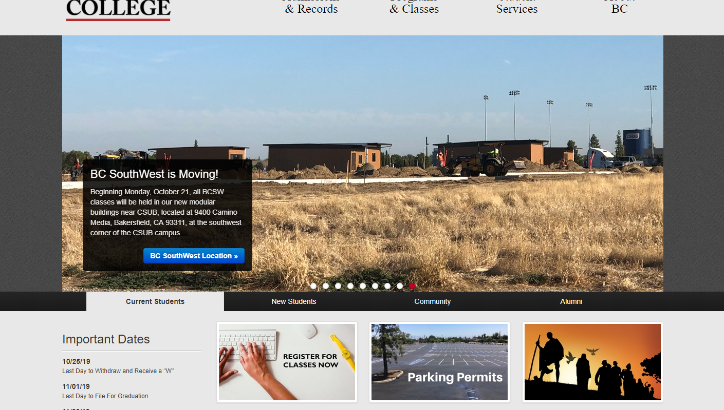

Slide 8
Any Questions?

