Slide 1

Bookstore Advisory Committee Update
Thorson Feb 11, 2019 Delivered to Admin Council

Slide 2

BAC Update
Unofficial Courses
ISSUE: Schedule Deadline
Bookstore Deadline
New Edition Protocol
Book Ordering percentages

Slide 3

BAC Update Preview Continued
Book Code Disclosure
Multi-term Benefits
Deadlines And Impacts
Late Start Classes
Required Books

Slide 4

Ordering For Unofficial Courses
Bookstore accepts
written documentation
(Chair/Dean)

Slide 5
ISSUE: Schedule Deadline vs. Contractual Bookstore Deadline
Chairs Submit Final Schedule Summer/Fall: Feb 7
Schedule Edits Adjustments to Schedule: Feb 25
Book Orders Due Per Contract : March 1
District Assigns CRN’s and makes visible: aprox May 6-7

Slide 6

Proposed Solution
Employee book list
Submitted by Chair

Slide 9
New Edition Protocol
“Bookstore processes will include emailing the professor and cc’ing the Chair if the textbook they ordered has a new edition and the professor has ordered an older one. Faculty will respond to the email in a professional timeframe to ensure ordering and student needs are met.”

Slide 10

Professional Time Frame
Refers to three business days

Slide 11

New Edition Protocol
Failure to respond results:
  order as originally requested,
    unless bookstore can’t find enough books

Slide 12

Current Process “Sales Through”

Slide 13
Book Ordering Percentages
“The bookstore will divulge the number of copies they ordered of the book title.”
    total max seats

Slide 14

One-time Use Book Code Disclosure
“the code may or may not be active.”

Slide 15

BAC Education Agreements
Help faculty understand
multi-semester benefits
deadlines impacts
late start classes
required books

Slide 16
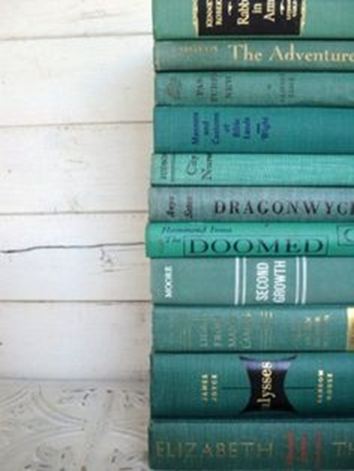
Multi-term Benefits To Students
Rentals
Availability
Sales-through rate

Slide 17

Deadlines and Impacts
“The BAC will help ensure that the deadlines are met for all orders on all courses that are scheduled and known. BAC will also help faculty understand the delays involved in older editions or out of print editions.”

Slide 18
Late Start Classes
“Instructors teaching late start classes will consider using books the bookstore currently has in stock in order to ensure students have books at the start of the course.”

Slide 19

Required Books
“Faculty will ensure any book listed as “required” on the syllabus is reported as “required” to the bookstore so they can adequately prepare for the need.”

