Slide 1
VETERAN SERVICES & VET WEEK
  Paul Beckworth – Faculty Director, Veteran Services
  October 8, 2018 Administration Council
  pbeckwor@bakersfieldcollege.edu

Slide 2
VETERAN SERVICES UPDATE
PERSONNEL
  PAUL BECKWORTH, FACULTY DIRECTOR
  ARMANDO TRUJILLO, VETERANS EDUCATION ADVISOR
  NICHOLE COOK, VA CERTIFYING OFFICIAL
  ADEANA WILLIAMS, 19/HR DA II
  (WORK CLOSELY WITH LISA KENT IN THE OFFICE OF STUDENT SUCCESS & EQUITY)

Slide 3
WHO ARE YOUR STUDENT-VETERANS?
785 IDENTIFIED VETERANS
25% FEMALE VETERANS
50% HISPANIC, 37% WHITE, 3% AFRICAN-AMERICAN
OVER 50% ARE BETWEEN THE AGES OF 25-40
47% GRADUATE WITHIN THREE YEARS
TOP THREE MAJORS~ BUSINESS, PRE-NURSING, PSYCHOLOGY

Slide 4
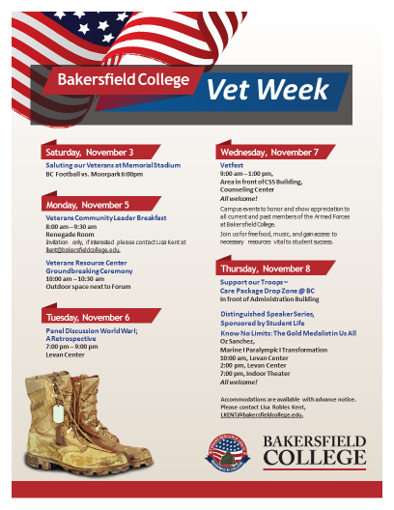

Slide 6


Slide 7


Slide 8


Slide 9



Slide 10
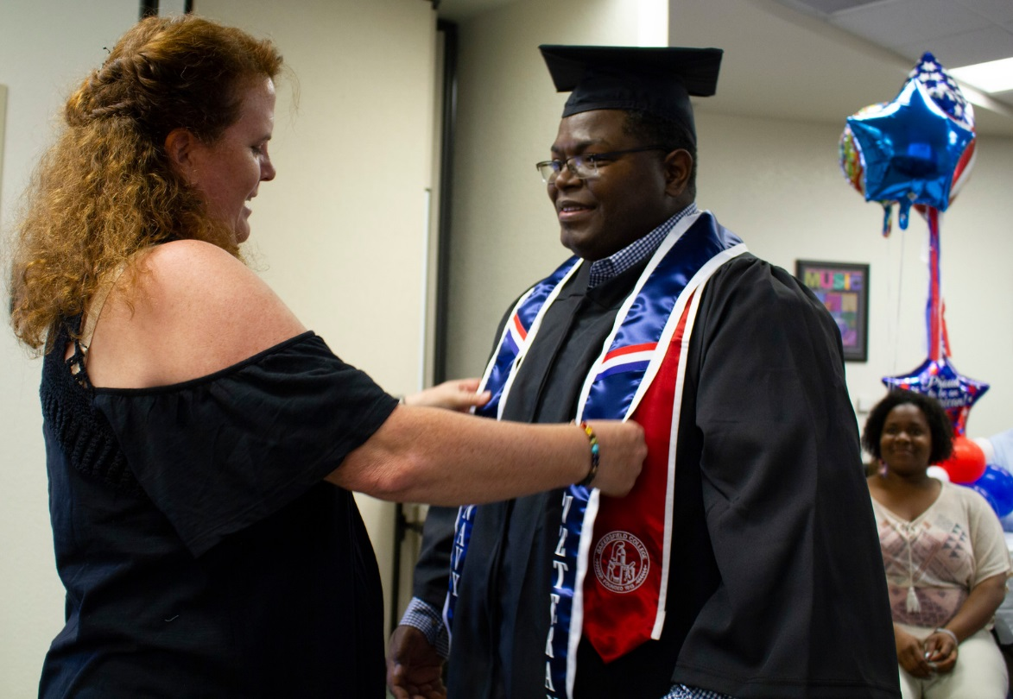
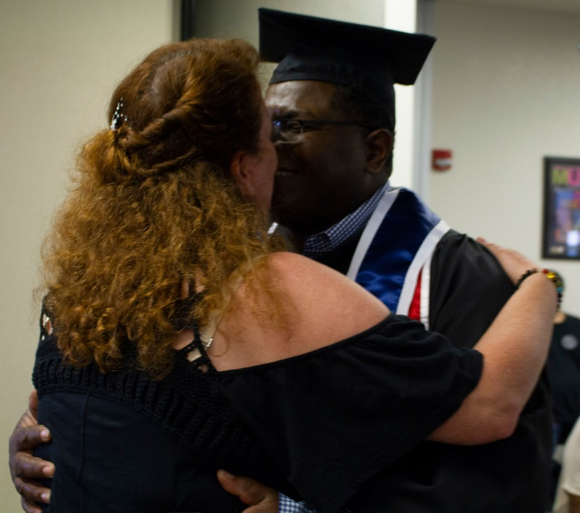
Let’s get them here!
https://www.bakersfieldcollege.edu/veterans

