Slide 1
Facilities Update
Administrative Council Meeting
October 8, 2018

Slide 2
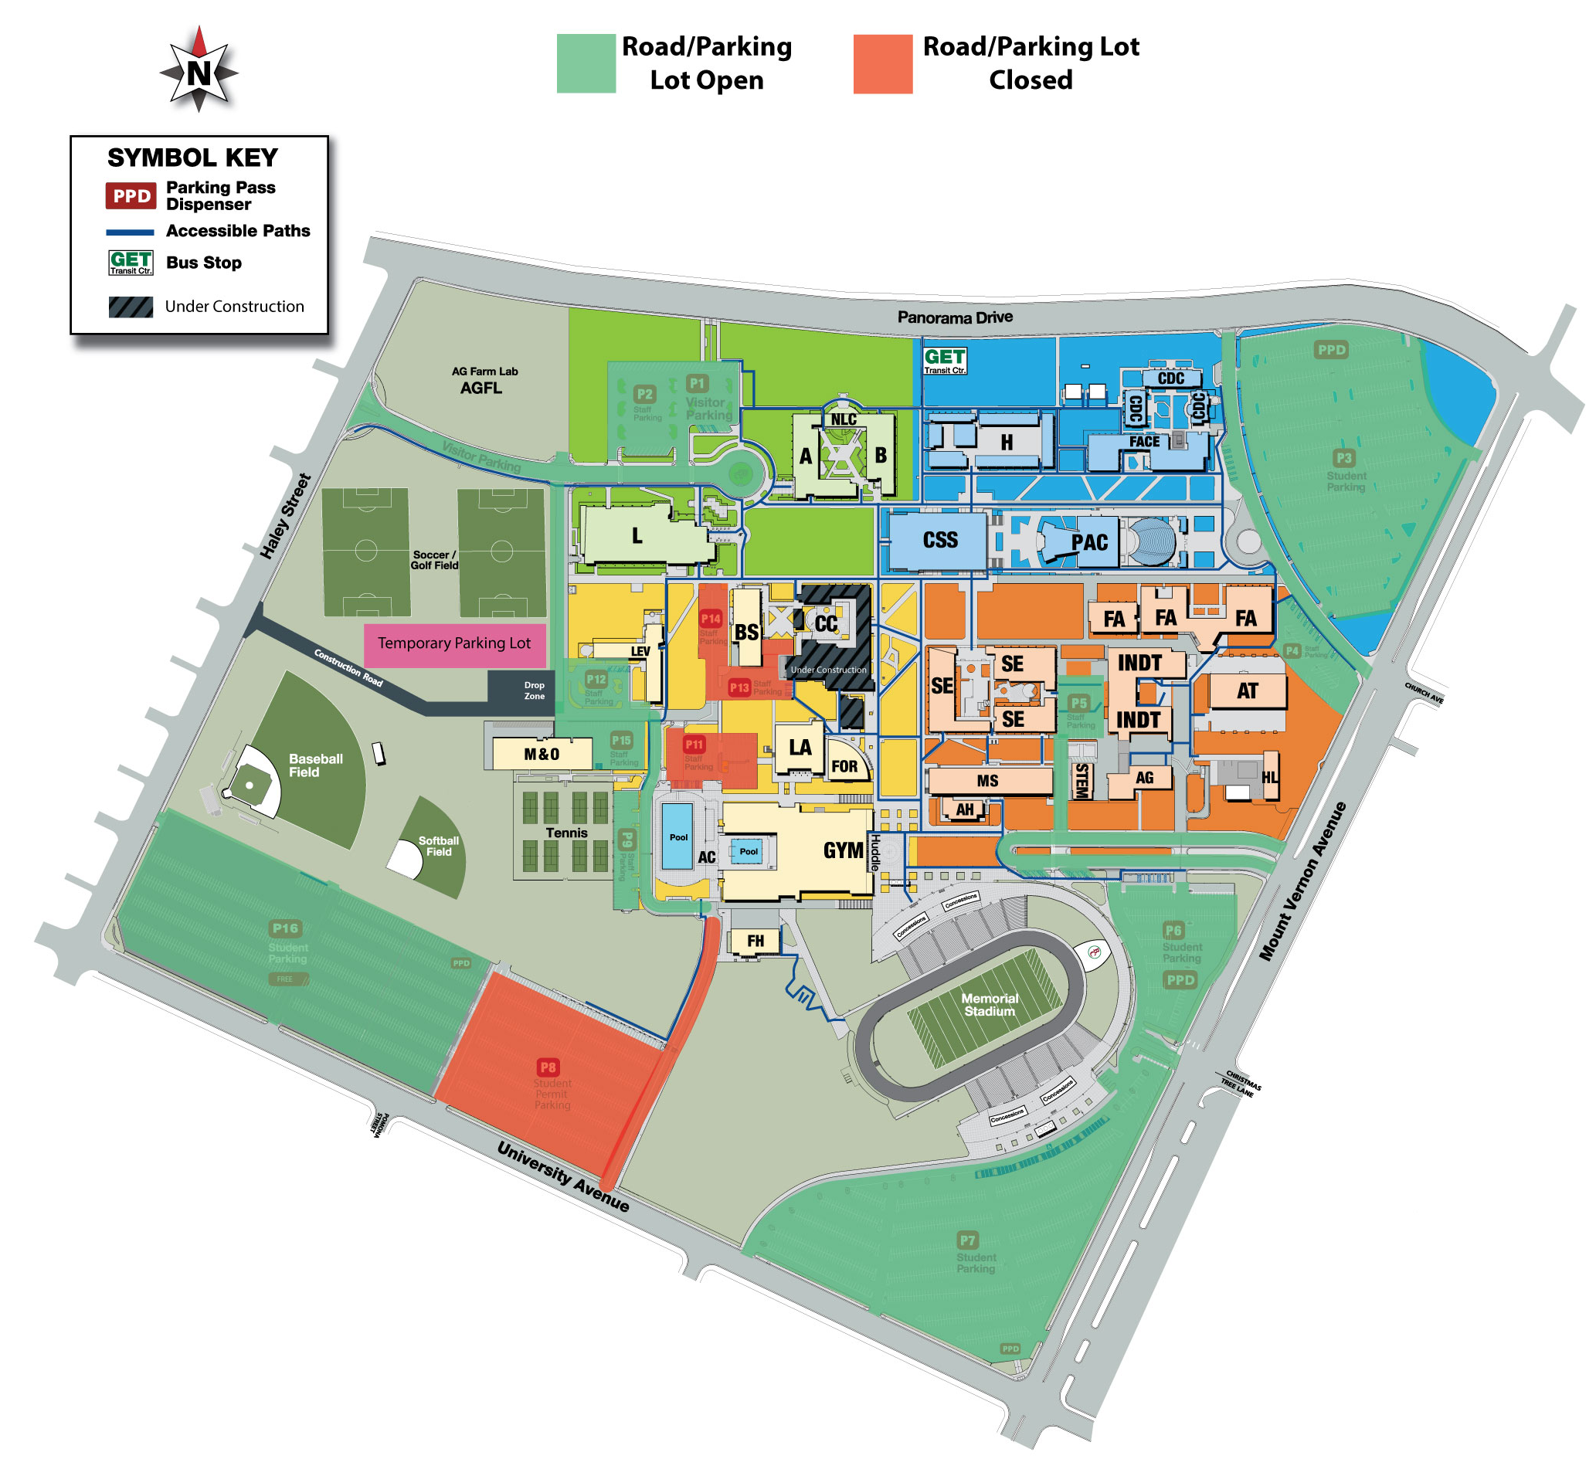
Measure J Projects
Parking
Final phase
P8, P11 closed
P9 closes 10/8
Road from University closed 10/8-10/15
All lots reopen 10/15
Overflow parking on grass field

Slide 3
Current Measure J Projects
Huddle and Mount Vernon Commissary (MVC)
Kitchen moving in December during break
Huddle is ready for Food Services
Will have BC food truck on campus serving food
VRC demolition has begun
Groundbreaking on November 5
Scheduled for completion at end of November 2019
Wireless infrastructure project
Evening work and will improve interior Wi-Fi on campus

Slide 4
Upcoming Measure J Projects
Campus Center tenants moving to LEV this month
SGA moving week of 10/8
Veterans moving week of 10/22
Health moving week of 10/29
Demolition of Campus Center begins in December
Groundbreaking date TBD
Scheduled for completion at end of October 2020

Slide 5
Upcoming Measure J Projects
Science & Engineering Building
RFQ process right now
Selecting a Design-Build team now
Scheduled for completion in December 2021
Gym
Advertising for a Design-Build team
Will select that team within the month
Scheduled for completion in December 2022
Stadium
December 15, 2018 through August 31, 2019

