Slide 1
ISER Committee Presentations
BAKERSFIELD COLLEGE

Slide 2
Accreditation Basics
Accrediting Commission for Community and Junior Colleges (ACCJC) evaluates and accredits Junior Colleges
Accreditation allows our students to receive federal financial aid dollars
Allows us to engage in continuous evaluation and quality improvement

Slide 3
ACCJC
Our evaluation team is comprised of educators and administrators
ACCJC has established four major accreditation standards
Under those four standards are 14 subsections
We demonstrate compliance via a written self report…the Institution Self-Evaluation Report (ISER)

Slide 4
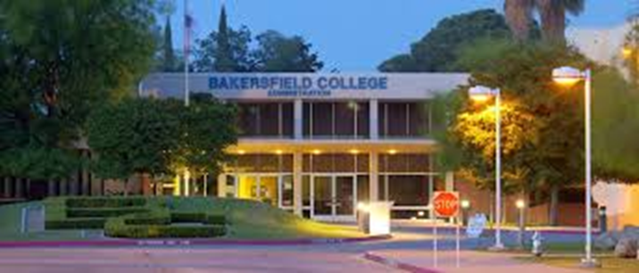
Standards
Standard I: Mission, Academic Quality, and Institutional Effectiveness and Integrity
Standard II: Student Learning Programs and Support Services
Standard III: Resources
Standard IV: Leadership and Governance

Slide 5
ISER
The ISER explains how we meet the 4 standards and all subsections
The ISER also contains a quality focus essay (QFE) describing goals
QFE highlights two projects-Program Mapper and Academic Support Services
ACCJC has our ISER, and peer reviewers are prepping for a site visit.
Our ISER is found here:
https://www.bakersfieldcollege.edu/accreditation/2018ISER
Notes:
Add information about the QFE, link the QFE to the mission

Slide 6
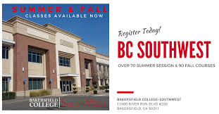
Site Visit
October 1-4th: the peer review team will be on campus, in our classrooms and in our committee meetings.
Each team member is responsible for verifying a specific standard.
They will talk with administrators, faculty, classified personnel, and students .
They will review all of our documents and data.
They will sit in our classes and will talk with committees.
Notes:
Add something about peer review team verifying the information presented in the ISER

Slide 7
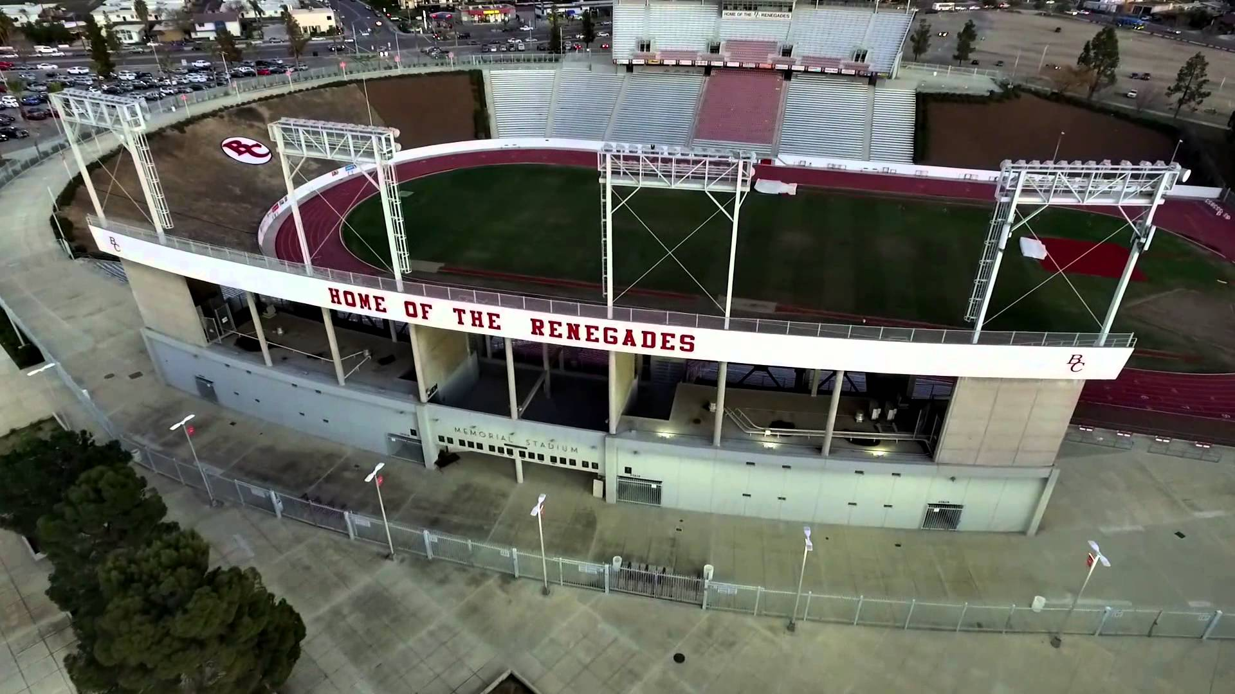
All Campus Preparation
Everyone should be familiar with-
Mission Statement
Strategic Directions
Institutional Learning Outcomes
Core Values
Student population
College Processes
Collegial Governance
See BC Cheat Sheet:
https://www.bakersfieldcollege.edu/download/27323

Slide 8
Committee Preparation
What is your committee’s charge? Where do you find it?
Do you understand how you are represented in the ISER?
We should use a common language
What standards and subsections apply to your committee?
How is your committee helping BC meet those standards?
Where can you locate the information?

Slide 9
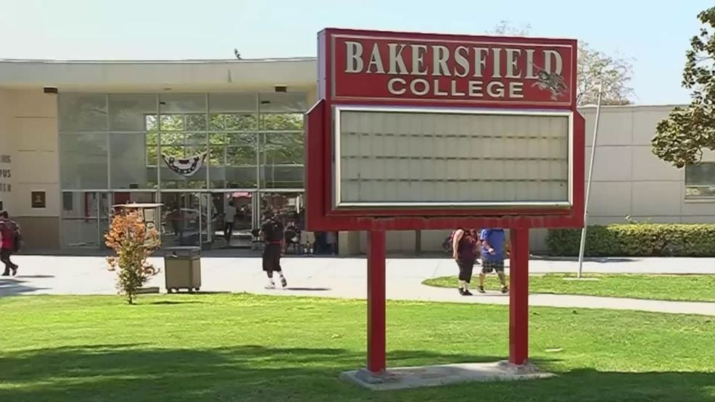
Where Can I Find My Committee Information?
https://committees.kccd.edu/bc/

Slide 10
Administrative Council- Charge
Administrative Council is a consultative body comprised of educational and classified administrators and managers. Administrative Council is a forum for communication on issues and trends affecting Bakersfield College, and communicates directly with the president of Bakersfield College.
Members of the Administrative Council serve at the discretion of the President, and provide the President a forum for vetting decisions prior to implementation. They strive to provide all possible viewpoints surrounding college-wide issues so the President can make decisions based on the widest possible perspectives.

Slide 11
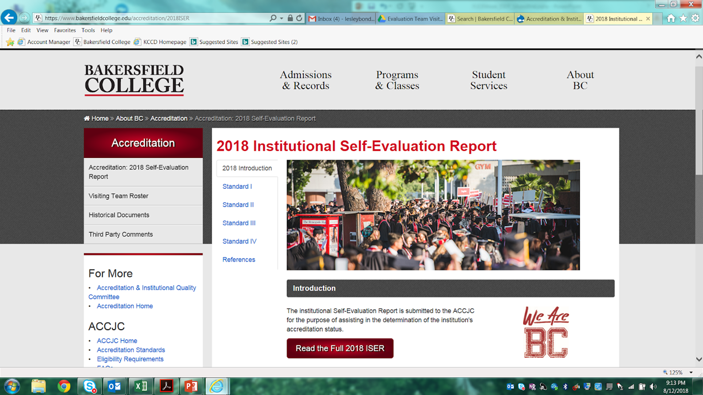
Where Are Mentioned in the ISER?
https://www.bakersfieldcollege.edu/accreditation
Click “Accreditation: 2018 Self-Evaluation Report” in upper left corner of page.
Click big red button that says “Read the Full 2018 ISER” in middle of page.
The word “Administrative Council” appears 11 times in the ISER.
ISER Bluff Notes: https://www.bakersfieldcollege.edu/download/27320
Notes:
Admin Council appears 2 more times, but those are references to KCCD Administrative Council- not BC Admin Council

Slide 12
Administrative Council in the ISER
The Administrative Council is integral to all sections of the ISER, but is revealed in Standards:
I.C.5
IV.A.1, 4, and 5.
the Index/Documentation.
Notes:
Ctrl + F and search results.

Slide 13
Standard I.C: Institutional Integrity
I.C.5 | The institution regularly reviews institutional policies, procedures, and publications to assure integrity in all representations of its mission, programs,
and services.
“Because BC embraces its mission, we regularly evaluate our policies, procedures, and publications
to identify best practices as well as obstacles we have unintentionally created that may prevent our
students from learning and achieving their educational goals. BC has intentionally designed a
structure to maximize college-wide engagement in the ongoing evaluation process.”
ISER page 53

Slide 14
Standard I.C: Institutional Integrity
I.C.5 | The institution regularly reviews institutional policies, procedures, and publications to assure integrity in all representations of its mission, programs,
and services.
Campus Group | Involvement in Evaluation & Revision
Administrative Council Educational and classified management | Strives to provide all possible viewpoints surrounding college-wide issues so the College President can make decisions based on the widest possible perspectives (I.C.5-6)
ISER page 53

Slide 15
Standard IV.A: Decision-Making Roles and Processes
IV.A.1 Innovation
…. When ideas for improvement have policy or significant institution-wide implications, systematic participative processes are used to assure effective planning and implementation.
Bakersfield College’s deeply rooted culture of dialog occurring in an intentionally-designed formal structure is what enables us to develop the innovations of practices we have described in our responses to Standard I, II, and III.
Admin Council plays a significant role in this culture of dialog, as you strive to evaluate and revise practices, programs and services.
ISER Page 134-5

Slide 16
Standard IV.A: Decision-Making Roles and Processes
IV.A.1 Decision making aligned with expertise and inclusion of diverse voices
“Collaboration is ubiquitous throughout Bakersfield College. Through committees in areas such as accreditation, curriculum, assessment, program review, and budget, BC ensures inclusion and consideration of appropriate constituent perspectives.”
“The BC Decision-Making Document describes FCDC and other operational groups
where decision-making is aligned with expertise and responsibility such as the Administrative Council, Student Affairs Leadership Team, and the Educational Administrators Council.”
ISER Page 139

Slide 17
Quality Focus Essay (QFE)
Continuous quality improvement is a mark of institutional effectiveness. The ISER results in a QFE that identifies areas of needed change, development, institutionalization, and expansion.
Our QFE identifies successes in the Guided Pathways project and development of Completion Coaching Communities. Furthermore, we link Guided Pathways and Strategic Directions for future educational innovations!
Our QFE identifies has two projects for improvement:
1: Clarify the Path with the Program Pathways Mapper.
2: Keep Students on the Path by Scaling and Integrating Student Support &
Learning.

Slide 18
Review: Admin Council’s ISER presence
Some key terms to associate with Admin Council’s footprint in the ISER:
Integrity
Inclusion
Systemic Participative governance
Responsibility
Transparency of processes

Slide 19
Full ISER Review
The ISER describes how BC has met the four standards and all subsections.
ACCJC peer review team has our ISER and is preparing for our site visit.
The team will be at BC October 1-4th and will talk with administrators, faculty, classified personnel, and students.
They will be talking with committee leaders and members about the ISER.
Please review the documents we’ve provided so that we have a common language and can articulate all we do.

Slide 20
We Are BC!
Brought to you by your friendly neighborhood Accreditation Team- under the auspices of AIQ.

