Slide 1
BC and KCCD Services and Institutional Quality Survey
For Services rendered in the Fall 2022 Term
November 2022

Slide 2
Survey Information
Survey Summary:
The Accreditation and Institutional Quality survey of BC and KCCD Services rendered in the Fall 2022 Term is an anonymous survey that will be shared and used to improve Bakersfield College.
Participants and Active Dates:
All BC Faculty, Staff, and Managers/Administrators were invited to participate using the BC All listserv
An estimated 1,061 Employees received the survey (KCCD Fast Facts on 2021-22 BC Employees)
The anonymous survey was released on 10/26/22 and closed on 11/09/22
Responses Received:
256 responses were received (24.1% Response Rate)

Slide 3
Indicate the extent to which you agree that the following Bakersfield College services and departments have provided you with effective service.

Slide 4
Indicate the extent to which you agree that the following Bakersfield College services and departments have provided you with effective service. (Continued)

Slide 5
Indicate the extent to which you agree that the following Bakersfield College services and departments have provided you with effective service. (Continued)

Slide 6
Indicate the extent to which you agree that the following Bakersfield College services and departments have provided you with effective service. (Continued)

Slide 7
Indicate the extent to which you agree that the following Bakersfield College services and departments have provided you with effective service. (Continued)

Slide 8
Indicate the extent to which you agree that the following Bakersfield College services and departments have provided you with effective service. (Continued)

Slide 9
Please indicate the extent to which agree that the office staff of the following offices provided you with effective service.

Slide 10
Please indicate the extent to which agree that the office staff of the following offices provided you with effective service. (Continued)

Slide 11
Indicate the extent to which you agree that the following KCCD offices and services (located in the downtown office building) are effectively supporting Bakersfield College in achieving its mission.

Slide 12
The BC President provides effective leadership in planning, organizing, budgeting, selecting and developing personnel, and assessing institutional effectiveness
(Standard IV.B.1).

Slide 13
KCCD clearly delineates their own operational functions from those of Bakersfield College (Standard IV.D.2).

Slide 14
KCCD effectively controls its expenditures (Standard IV.D.3).

Slide 15
KCCD and Bakersfield College effectively communicate with each other (Standard IV.D.7).

Slide 16
KCCD and Bakersfield College exchange information in a timely manner (Standard IV.D.7).

Slide 17
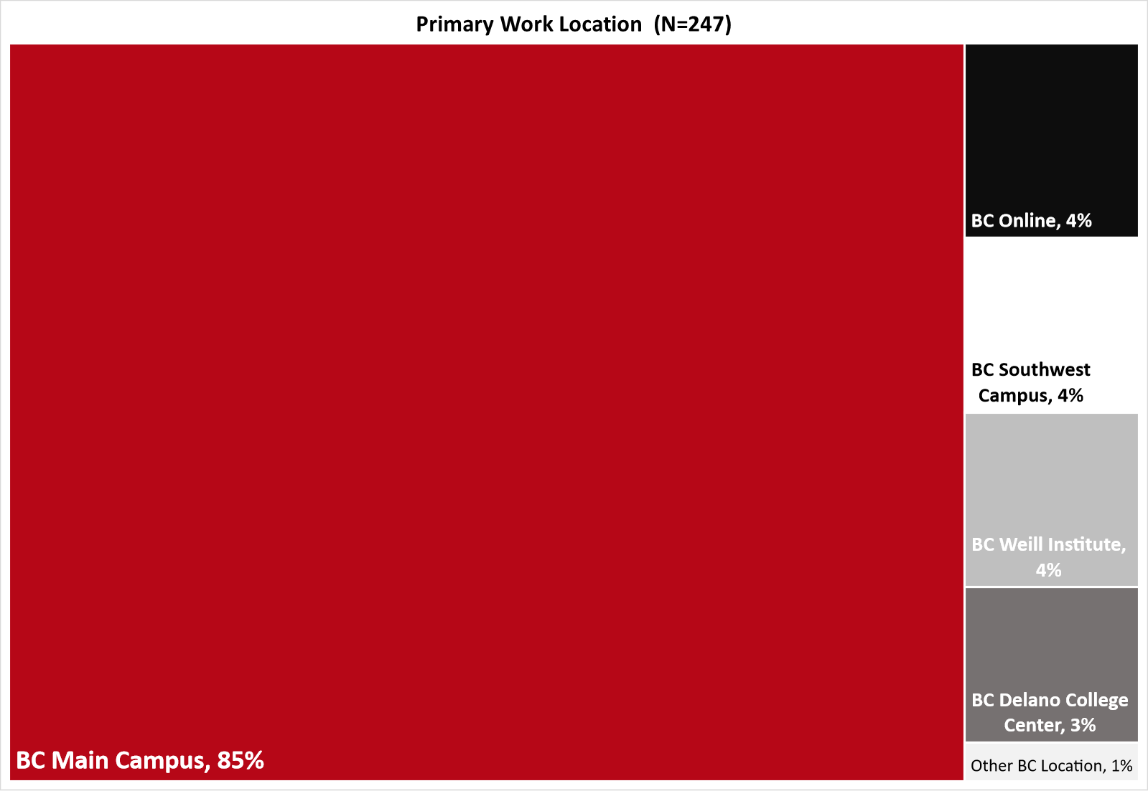
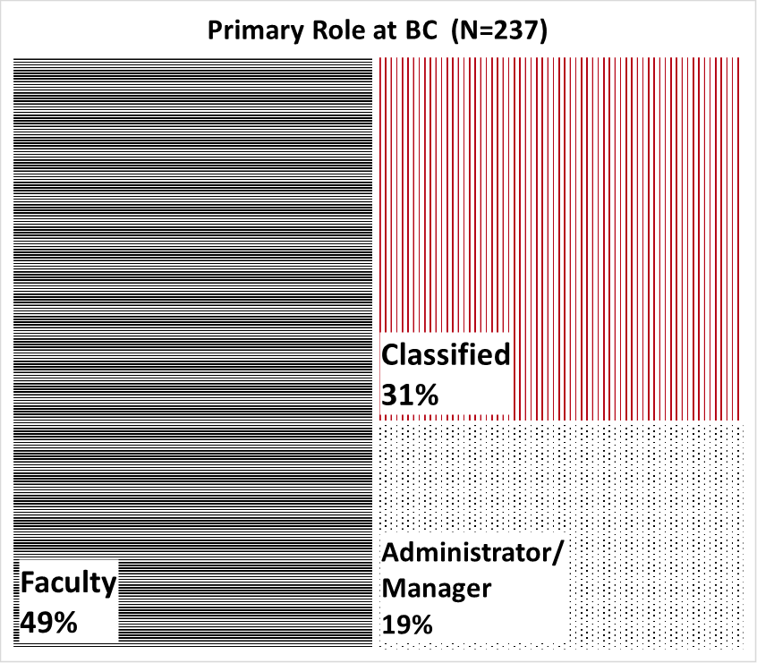
Work Location and Role at BC

Slide 18
Work Status and Years at BC

Slide 19
Committee Participation at BC

Slide 20
Committee Participation by Work Status
• Academic Senate
• Accreditation & Institutional Quality Committee (AIQ)
• Administrative Council
• Assessment Committee
• Budget Committee
• College Council
• Curriculum Committee
• Educational Administrators Council (EAC)
• Equal Opportunity & Diversity Advisory Council (EODAC)
• Facilities & Sustainability Committee
• Faculty Chairs/Directors Council (FCDC)
• Information Services & Instructional Technology (ISIT)
• Professional Development Committee
• Program Review Committee
• Safety Advisory Committee
• Student Affairs Leadership Team (SALT)

Slide 21
Gender Information

Slide 22
Sexual Orientation

Slide 23
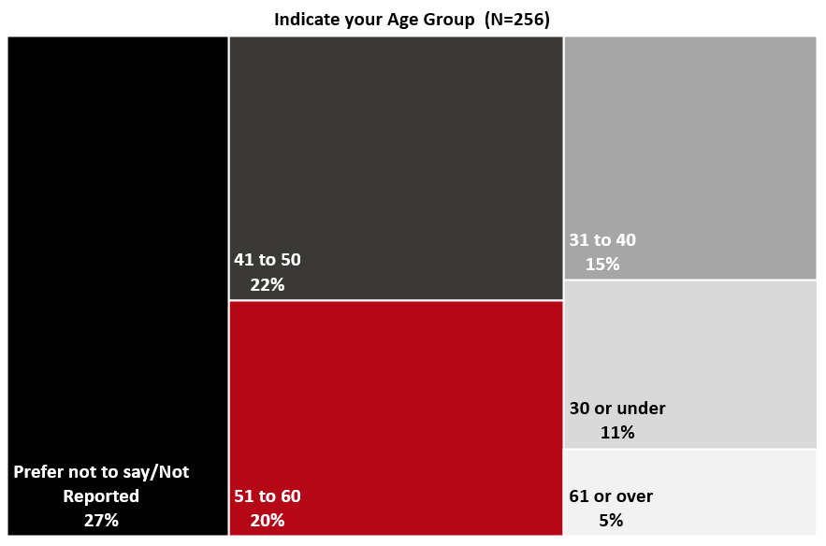
Age Group

Slide 24
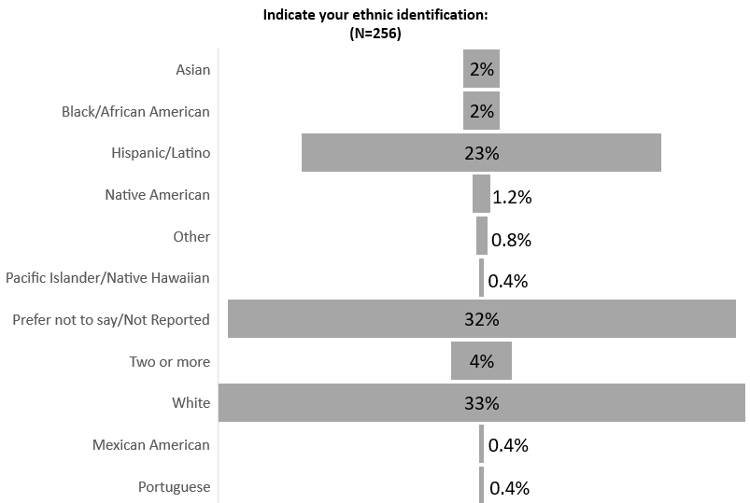
Ethnic Identification

