Slide 1
Short and Long-term Military Absence
Bakersfield College

Slide 2
PUBLIC LAW 116–315—JAN. 5, 2021 Johnny Isakson and David P. Roe “Veterans Healthcare Improvement Act of 2020”
Guiding Legislation
California Education Code § 99130
Military Absence & Withdrawal Protections
Applies to students in the California Community Colleges
and California State University systems
Requires institutions to excuse absences related to
military service
Prohibits academic or financial penalties due to
military-related absences
Requires institutions to provide reasonable
accommodation options, including make-up work or
withdrawal without negative consequences
‘‘(G) Maintain a policy that—
‘‘(i) ensures that members of the Armed Forces,
including the reserve components and the
National Guard, who enroll in a course of
education at the educational institution may be
readmitted at such institution if such members
are temporarily unavailable or have to suspend
such enrollment by reason of serving in the
Armed Forces; and
‘‘(ii) otherwise accommodates such members
during short absences by reason of such
service.

Slide 3
Short and Long-Term Military Absence KCCD AP 5013
Short-Term Options
Absences shorter than 30 days shall be considered “excused absences”
Instructor, VRC advisor, and servicemember collaborate to provide the servicemember with reasonable alternative arrangements
Student elects Military Withdraw retroactive to beginning of term
Request for Assignment of Final Grade if ≥ 75% of the term is completed
Incomplete “I” grade assigned
Long-Term Options
Absences longer than 30 days
Student elects Military Withdraw retroactive to beginning of term
Request for Assignment of Final Grade if ≥ 75% of the term is completed
Incomplete “I” grade assigned
Note: Faculty determines whether a final grade may be issued

Slide 4
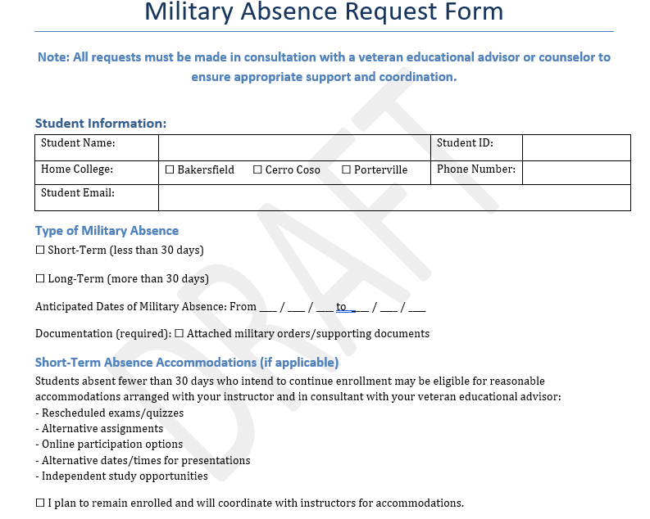
Military Absence Request Form - Explained
This form is not to be completed by students independently and will not be publicly advertised
Student must initiate communication with veteran educational advisor, who will reach out to faculty to begin process of collaboration
These dates can fluctuate depending on the needs of the military
Student, VRC Advisor, and Faculty collaborate to determine the most appropriate academic option.
Faculty input is essential for feasibility of coursework continuation or grading options
VRC Confirmation & Notification
VRC sends a confirmation email CCing:
Admissions & Records (A&R listserv)
Faculty
Student
Subject Line Example:
URGENT: Military Short-Term / Long-
Term Absence
Request for Student Name, BC ID —
CRN 12345 ENGL B1A
Student may also select any of the long-term options.

Slide 5
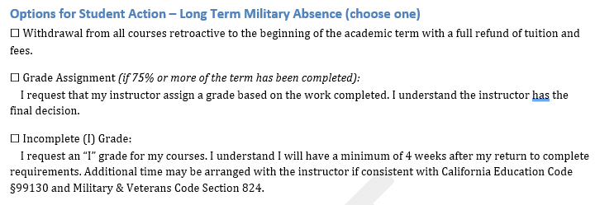
Military Absence Request Form – Student Action for Long Term
Long-Term Absence requests also require the student to meet with VRC Advisor
Advisor: Explains long-term academic and withdrawal options and impact to VA educational benefits
The long-term option is recommended for absences >30 days, but may also be elected for absences <30 days
Military Withdrawal (MW) initiates refund (Education Code § 99130 & Military & Veterans Code § 824) allowing students called to active military duty during a term to withdraw retroactively to the term's start for a full tuition/fee refund
VRC sends confirmation email
(CC A&R, faculty, student)
If student requests grade assignment, faculty discretion applies (Ed Code § 99130)
Student has up to one year from release from active-duty activation to request a change from the initial elected relief option
Long-term option is required to prevent automatic “F” grade assignment

Slide 6
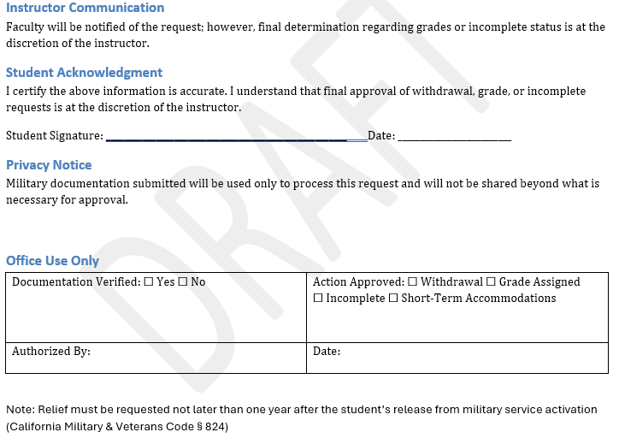
Military Absence Request Form – Final Steps
In most cases, students will have the opportunity to connect with the VRC and/or faculty before their activation commences. At times, military movement is provided with short notice or may be classified in nature.
The VRC will make every effort to coordinate relief and obtain signature of student in the case that the student is not present to do so themselves.
Final packet, to include this document, will be forwarded by VRC to A&R for action, compliance, and record

